Slide 1
Linguistics in the second half of the 19th century

Slide 2
Linguistics in the second half of the 19th century
August Schleicher’s biological approach to language.
Origins of psycholinguistics.
Alexander Potebnja’s philosophy of language.
Neogrammarian theories.

Slide 3
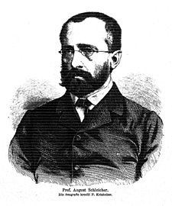
August Schleicher’s biological approach to language
August Schleicher (1821-1868),
German linguist
“A Compendium of the Comparative Grammar of the Indo-European Languages”
Subtitle: Outline of a phonology and morphology of the Indogermanic parent language

Slide 4
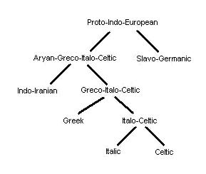
August Schleicher’s biological approach to language
August Schleicher’s Stammbaumtheorie
(genealogical tree model)

Slide 5
August Schleicher’s biological approach to language
August Schleicher ’s Stammbaumtheorie
(genealogical tree model)
Criticism:
a very literal presentation of language history
languages do not sharply split at a given point at a time
the split is not complete, as certain sets of features are shared by different groups of languages within one family
it suggests that dialectal divisions are the most recent feature of linguistic history, since dialects occur at the end points of the tree

Slide 6
August Schleicher’s biological approach to language
Biological nature of August Schleicher ’s Stammbaumtheorie
It was in line with Darwinian ideas prevalent in the second half of the 19th c.
In 1863 Schleicher published a short treatise on Darwinian theory and linguistics:
He regarded himself as a natural scientist and language as one of the natural organisms of the world.
Independently of its speakers’ will or consciousness, a language has its periods of growth, maturity and decline.
Darwin’s theory worked out for animal and vegetable kingdoms was broadly appropriate for linguistic history.
Diffusion of languages over the earth’s surface, their contacts and conflicts are similar to animals’ struggle for existence.
In this struggle the Indo-European languages were victorious.

Slide 7

August Schleicher’s biological approach to language
Biological nature of August Schleicher ’s Stammbaumtheorie
Schleicher regarded the three current language types, isolating, agglutinating and inflectional, as representing historical stages in the growth of languages to the highest point in their organization.
unitary Ursprache – growth period, mature undamaged stage
subsequent evolution - decline
Schleicher about English: its history shows how quickly the language of a people important in history and in literary history can decline

Slide 8
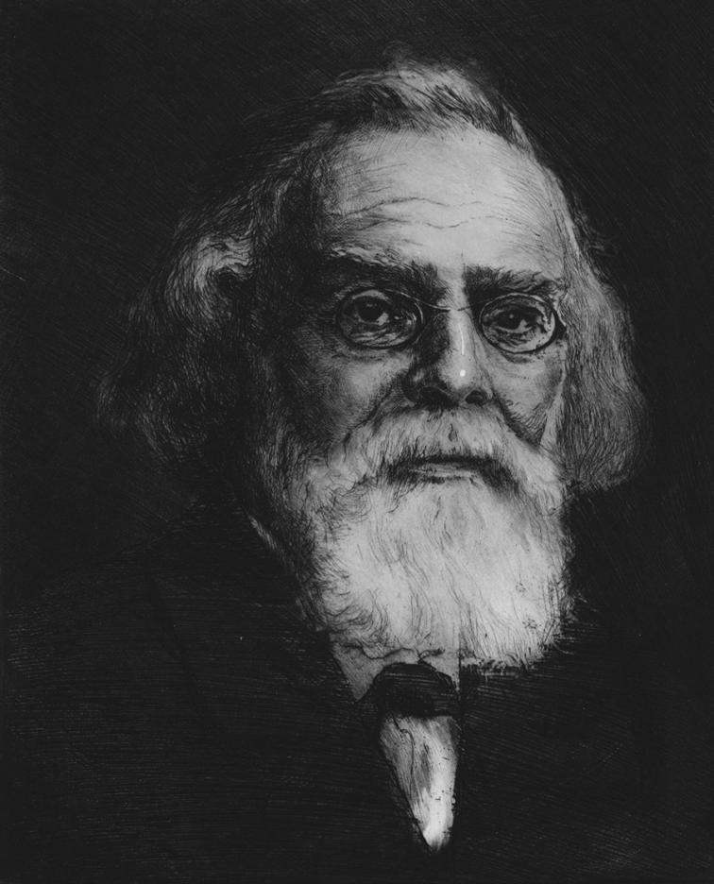
Origins of psycholinguistics
Heymann Steinthal (1823–1889)
inventor of the psychology of language
professor in general linguistics and in biblical exegesis, Berlin
“Felicitous advances in linguistics presuppose an advanced psychology.”
1871 “Introduction to psychology and
linguistics”

Slide 9
Origins of psycholinguistics
Heymann Steinthal
“In just the same way as any embryo builds this or that organ during a particular phase of its development, at some definite point the mind necessarily builds language, today, as in the primeval era.”
Linguistics can only be psychological

Slide 10
Origins of psycholinguistics
Heymann Steinthal: The study of apperception is the main task of psychology.
Apperception is a two-sided process:
Apperception - comprehending (a new idea) by assimilation
with the sum of one's previous knowledge and experience.
psychological subject, idea in the speaker’s mind
(apperceiving element)
second idea, psychological predicate
(that which is apperceived)

Slide 11
Origins of psycholinguistics
Heymann Steinthal
The unknown is interpreted in terms of the known and the known is sometimes given a new interpretation in the light of the new information.
unknown
known

Slide 12
Origins of psycholinguistics
Heymann Steinthal
specified the notion of Humboldt’s inner language form:
it is the bond between speech sound and signified.
How does sound become bound to the signified?
It is possible because some members of the mass of old perceptions hold something in common with the new perception. This common element unites the new with the old and as inner language form becomes the actual content of the sound complex.
Thus:
sound - embodiment of thought
inner language form – manner of embodiment

Slide 13
Origins of psycholinguistics
Heymann Steinthal
In the civilized language user practically any idea is a word-idea. Any idea in consciousness is just the abstract reference of a word to its unconscious meaning complex. This internal speech form has little or no content.
For the speaker it is no more than a sign in consciousness, which got there through activation by the always active underlying, unconscious meaning complex.
For the hearer it is also the conscious word sign, which can activate the same underlying apperceptive mass, which is, psychologically, the word’s meaning.

Slide 14
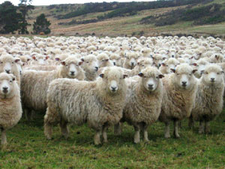
Origins of psycholinguistics
Heymann Steinthal
Any thinking, any creative mental process is unconscious.
It is the never ending apperceptive interaction of association and dissociation.
These highly complex events are consciously represented as words and sentences.
Consciousness need not carry the weight of mental content, but it represents it.

Slide 15
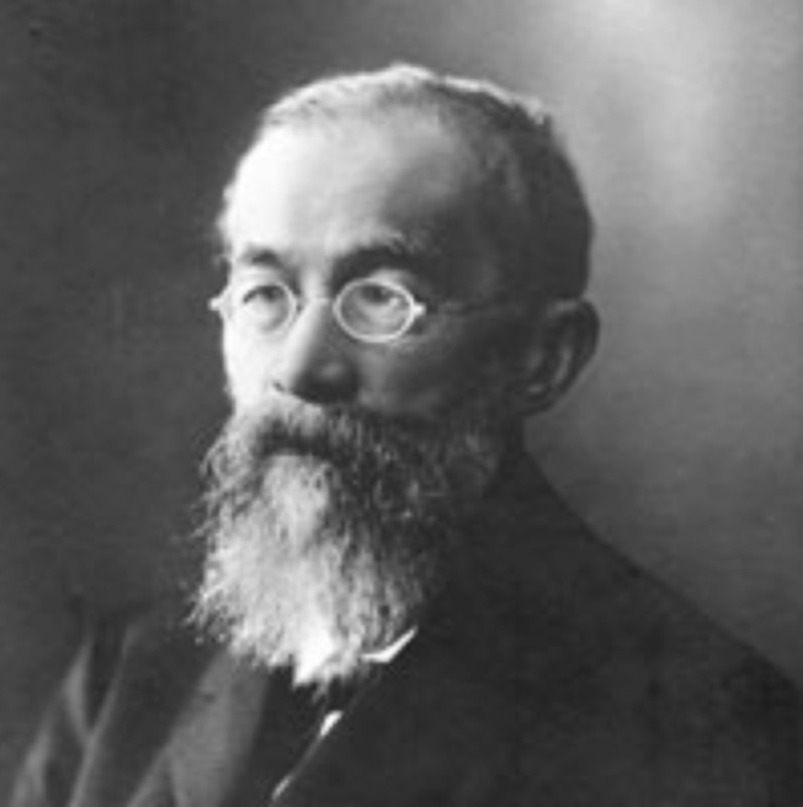
Origins of psycholinguistics
Wilhelm Wundt’s (1832– 1920) ethnic psychology
“Volkerpsychologie”
addresses the “higher” mental processes from the point of view of their cultural products, such as language, myth, and custom.
The evolution of these complex cultural phenomena, according to Wundt, reflects the evolution of human consciousness.

Slide 16

Origins of psycholinguistics
Wilhelm Wundt
the history of human consciousness, the evolution of thought, can be read from the linguistic phenomena at hand, somewhat like the astronomer who can today observe what happened billions of years ago in the universe.
Analysing these still available phenomena is Wundt’s road into understanding the “higher” psychological mechanisms, the structure of mind.
The structure of a language reflects the level of intellectual development of its users.

Slide 17
Origins of psycholinguistics
Wilhelm Wundt
Language, whether spoken, gestural, or written, is an expressive movement, which can serve the intention of communicating thoughts, feelings and inner states.
Children’s acquisition of the language:
Not a single word could be identified as independently invented by the child. A child “ignorantly” imitates words from his environment before he attaches any meaning to them (“echo speech” ).
“After all, children’s speech is a product of the child’s
environment, in which the child itself is, essentially, only passively involved.”

Slide 18
Origins of psycholinguistics
Wilhelm Wundt
Sound changes:
contact effects (assimilation and dissimilation)
distant effects (analogy)
regular sound change (i.e. Grimm’s law)

Slide 19
Origins of psycholinguistics
Wilhelm Wundt
Origins of ongoing new word formations:
the slang of students,
the technical terms of scholars,
sound and word reduplication ( mama , bonbon )
word compounding ( household ).
NO AFFIXATION
Innovative syntactic perspective:
When you speak, you start building a sentence from a “total image” ( Gesamtvorstellung ), which you then successively analyze into smaller images or concepts that go with words.

Slide 20
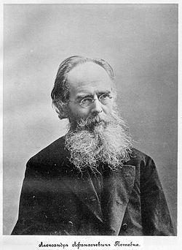
Alexander Potebnja’s philosophy of language.
Alexander Potebnja (1835-1891) - Ukrainian philosopher and linguist, professor of linguistics at the University of Kharkov
«Мысль и язык» (1862)
«О связи некоторых представлений в языке» (1864)
«Из записок по русской грамматике» (1874)
«Язык и народность» (1895)
Major fields of linguistic work:
the philosophy of language
the historical phonetics of the East Slavic languages,
etymology
Slavic historical syntax.

Slide 21
Alexander Potebnja’s philosophy of language.
Alexander Potebnja
Language is the means by which the mind orders the influx of impressions and stimuli.
Words carry not only a meaning, but also the past experience of the individual and the nation, through which all new experience is filtered.
Thus a word usually has three aspects: an external form, a meaning, and an internal form. It is through the internal form that the objective world is subjectivized. In many cases the internal form is rooted in myth and, hence, acts as a bridge between language and folklore (with its symbols).

Slide 22
Alexander Potebnja’s philosophy of language.
Alexander Potebnja
1862 Мысль и язык:
«В слове мы различаем: внешнюю форму, т.е. членораздельный звук, содержание, объективируемое посредством звука, и внутреннюю форму, или ближайшее этимологическое значение слова, тот способ, каким выражается содержание. При некотором внимании нет возможности смешать содержание с внутреннею формою. Например, различное содержание, мыслимое при словах жалованье, лат.annuum, pensio, франц. gage, может быть подведено под общее понятие платы; но нет сходства в том, как изображается это содержание в упомянутых словах: annuum – то, что отпускается на год, pensio – то, что отвешивается, gage первоначально – залог, ручательство, вознаграждение и проч., вообще результат взаимных обязательств, тогда как жалованье – действие любви, подарок, но никак не законное вознаграждение, не следствие договора двух лиц».
Таким образом, внутренняя форма – это след того процесса, при помощи которого языком было создано данное слово, «сохраняющийся в слове отпечаток того движения мысли, которое имело место в момент возникновения слова»
(Ю.С. Маслов)
Кукушка - потому что она кричит «ку-ку!»,
Окно – око, («окна у дома – как глаза у человека»)
Черника – цвет ягоды
Воспитание – питание ребенка как составная часть его воспитания

Slide 23
Alexander Potebnja’s philosophy of language.
есть внутренняя форма
темница
светлица
внутренняя форма утрачена
тюрьма
комната

Slide 24
Alexander Potebnja’s philosophy of language.
Language and nation
Regarding language as an individual's or a nation's only possible means of perceiving the world and of thinking, Potebnja protested against denationalization in general and the Russification of Ukrainians in particular, and equated this process with spiritual and intellectual disintegration.

Slide 25
Alexander Potebnja’s philosophy of language.
Creative nature of language
Показати справжню участь слова в утворенні послідовного ряду систем, які обіймають собою відношення особистості до природи… В загальних рисах ми вірно зрозуміємо значення цієї участі, якщо прийняли основне положення, що мова є засобом не виражати вже готову думку, а створювати її, що вона не відображення світогляду, який уже склався, а діяльність, що його складає.
(А.А.Потебня. Мысль и язык).

Slide 26
Alexander Potebnja’s philosophy of language.
«всяке розуміння є нерозуміння»
Почуту фразу кожен розуміє не зовсім так (у такому обсязі), як той, хто її вимовив. Це розуміння залежить від життєвого досвіду, інтелектуального розвитку, психічних особливостей індивіда тощо.
Молчи, скрывайся и таи
И чувства и мечты свои –
Пускай в душевной глубине
Встают и заходят оне
Безмолвно, как звезды в ночи, –
Любуйся ими – и молчи.
Как сердцу высказать себя?
Другому как понять тебя?
Поймет ли он, чем ты живешь?
Мысль изреченная есть ложь.
Взрывая, возмутишь ключи, –
Питайся ими – и молчи.
(Ф. Тютчев. Silentium!)

Slide 27
Alexander Potebnja’s philosophy of language.
The sphere of language and the sphere of thought do not coincide
На зорі людства думка відставала від мови, на середньому етапі розвитку людства вони розвивалися паралельно, а на третьому етапі (етапі абстрактності) думка покидає мову як таку, що не задовольняє її вимог.
Саме цим можна пояснити, що думка художника, скульптора, музиканта реалізується не у слові, а думка математика втілюється в умовних знаках.

Slide 28
Alexander Potebnja’s philosophy of language.
“Compression of thought”
«згущення думки», тобто зведення різноманітних явищ до порівняно невеликої кількості знаків чи образів, що особливо яскраво ілюструють байки і прислів'я: образ байки завжди стосується багатьох осіб і ситуацій; це саме можна сказати й про прислів'я.
У слові згущення думки є його природним станом (воно майже завжди співвідноситься з багатьма денотатами).

Slide 29
Alexander Potebnja’s philosophy of language.
Close and distant meanings of a word
«Очевидно, мовознавство не відхиляючись від досягнень своїх цілей, розглядає значення слів тільки до певної межі. Так як говориться про всілякі речі, то без згаданого обмеження мовознавство містило б у собі, крім свого незаперечного змісту, про який не міркує жодна інша наука, ще зміст усіх інших наук. Наприклад, говорячи про значення слова дерево, ми повинні би перейти в галузь ботаніки, а з приводу слова причина або причинового сполучника – трактувати про причинність у світі. Але справа в тому, що під значенням слова взагалі розуміються дві різні речі, з яких одну, що підлягає віданню мовознавства, назвемо ближчим, іншу, що становить предмет інших наук, – дальшим значенням слова. Тільки одне ближче значення становить дійсний зміст думки під час вимови слова».

Slide 30
Alexander Potebnja’s philosophy of language.
Polysemy
Слово живе тільки в мовленні, де воно відповідає одному акту думки, тобто має лише одне значення >> Найменша зміна у значенні слова робить його іншим словом >> немає полісемії , а є тільки омонімія.

Slide 31
Psychological linguistics
Germans focused on psychological aspects (language in psychology)
Potebnja focused on grammatical aspects, language categories and their formal expression
(psychology in language)

Slide 32
Neogrammarian theories
The Neogrammarians (also Young Grammarians; German: Junggrammatiker) were a German school of linguists, originally at the University of Leipzig, in the late 19th century.

Slide 33
Neogrammarian theories
The essence of Neogrammarian theory was set forth in an article in a journal founded by its two major proponents, Herman Osthoff and Karl Brugmann:
all sound changes as mechanical processes take place according to laws that admit no exceptions within the same dialect (Verner’s law that resolved the exception to Grimm’s law)
the same sound will in the same environment always develop in the same way
BUT: analogical creations and reformations of specific words are equally a universal component of linguistic change

Slide 34
Neogrammarian theories
Existence of comparative and historical linguistics as a science rested on the assumption of regularity of sound change.
The history of a language is traced through recorded variations in the forms and meanings of its words .
Languages are proved to be related if they have words bearing formal and semantic correspondences which can not be explained by mere chance or recent borrowing.
If sound change were not regular and correspondences not reliable linguistic relations could only be established historically, by extralinguistic evidence (Romance languages)

Slide 35
Neogrammarian theories
“There must be a rule for exceptions to a rule; the only question is to discover it”
Karl Verner

Slide 36
Neogrammarian theories
Grimm and contemporaries
German Romanticism
Schleicher
Darwinian theory
Neogrammarians
historical linguistics is an exact science with methods to match natural science

Slide 37
Neogrammarian theories
Sound laws proceed by blind necessity, independently of the individual’s will.
BUT:
Language is not a supra-individual organic entity with its own growth and life (Humboldt and Schleicher).
Language has its existence in the individuals composing a speech community .
Linguistic changes were changes in individuals’ speech habits.

Slide 38
Neogrammarian theories
Opposed the theory of language growth, maturity and decline.
Scientific treatment of a language can only be historical treatment.
Drew attention away from the Ursprache as a prehistoric reality to the data of written records and contemporary spoken languages.
IE forms (*) are formulae rather than actual words

Slide 39
Neogrammarian theories
Osthoof and Brugmann:
“Only that comparative linguist who forsakes the hypothesis-laden atmosphere of the workshop in which Indogermanic root-forms are forged, and comes out into the clear light of tangible present-day actuality in order to obtain from this source information which vague theory cannot ever afford him, can arrive at a correct presentation of the life and the transformations of the linguistic forms”

Slide 40
Neogrammarian theories
Before neogrammarians:
THEORY ORIENTATION
Neogrammarians: DATA ORIENTATION

Slide 41
Neogrammarian theories
Deficiencies of neogrammarian theory:
Humboldt’s structural conception of language (innere Sprachform) found no place in their theory, thus the object of investigation was reduced from the language system to idiolect (language localized in an individual)
restricted themselves to description of surface phenomena (sound level)

Slide 42
Neogrammarian theories
Influence
gave a powerful impetus to the development of phonetics
(never again confusing written letter with spoken sound)
encouraged earnest studies of living dialects, publication of dialect atlases
drew attention to linguistic borrowing as a universal feature in the history of language and the study of loan-words
drew attention to analogy as an ever present tendency in language development

Slide 43
Neogrammarian theories
Criticism (mainly from specialists in dialectology and linguistic geography)
geographical dialect divisions are in constant fluctuation and are not clear-cut
where is the line beyond which a dialect becomes an idiolect?
why do some words change before others where the same sounds are involved?
many individuals carry more than one social and regional dialect
many unpredictable factors interfere with the expected sound change (homonymy, false etymology, similarity with taboo-words, social prestige, etc.)

