Slide 1
Structuralism, Generative grammar and Neo-Humboldtian theories

Slide 2
Structuralism, Generative grammar and Neo-Humboldtian theories
Prague linguistic school.
Louis Hjelmslev’s glossematics.
American descriptive linguistics.
Noam Chomsky’s generative grammar.
Neo-Humboldtian theories.

Slide 3
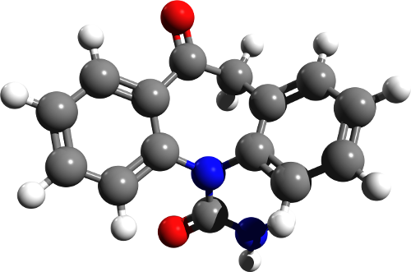
Structuralism
an approach in academic disciplines in general that explores the relationships between fundamental principal elements in language, literature, and other fields upon which some higher mental, linguistic, social, or cultural "structures" and "structural networks" are built.

Slide 4
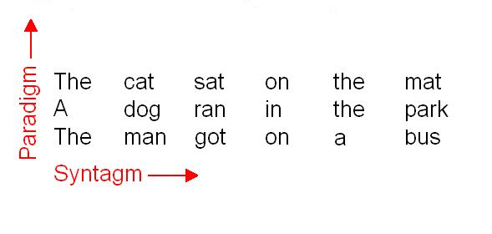
Structuralism
Ferdinand de Saussure’s works were the starting point of the 20th century structural linguistics.
This approach focused on examining how the elements of language related to each other as a system of signs, that is, 'synchronically' rather than how language develops over time, that is, 'diachronically'.
Key notions of structural linguistics:
paradigm – class of linguistic units which are possible in a certain position in a given linguistic environment
syntagm – linguistic environment, a sequence of linguistic units (a sentence)
value – functional role of the members of a paradigm

Slide 5
Prague linguistic school
The Prague school or Prague linguistic circle was an influential group of linguists, philologists and literary critics in Prague in the first half of the 20th c.
They developed methods of structuralist analysis and a theory of the standard language and of language cultivation.
Main interests: phonological theory
Major work: N. Trubetzkoy’s Grundzüge der Phonologie

Slide 6
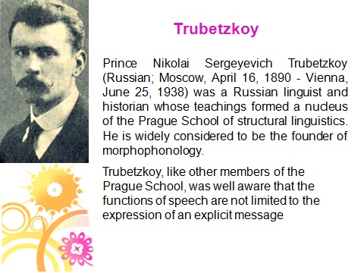
Prague linguistic school

Slide 7
Prague linguistic school
In 1928, the Prague Linguistic Circle group of Jakobson, Mathesius, Trubetzkoy, and others announced a radical departure from the classical structural position of Ferdinand de Saussure.
They suggested that their methods of studying the function of speech sounds could be applied both synchronically, to a language as it exists, and diachronically, to a language as it changes.

Slide 8
Prague linguistic school
applied Saussurean theory to the elaboration of the phoneme concept
speech sounds belong to speech and phonemes belong to language
treated phonemes not as a mere class of sounds or as a transcriptional device but as complex phonological unit realized by the sounds of speech

Slide 9
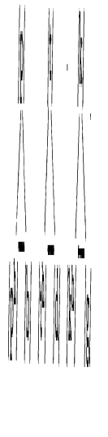
Prague linguistic school
phonological oppositions
each phoneme is composed by a number of separate distinctive features and each distinctive feature stands in a definite opposition to its absence or to another feature in at least one other phoneme in the language
Opposition of voicelessness and voice in English plosives:
/p/-/b/, /t/-/d/, /k/-/g/ pet-bet, tuck –duck, call-gall
Ancient Greek had a three term plosive system:

Slide 10
Prague linguistic school
phonological oppositions
Analysis of phonemes as ordered sets of specific contrasts between a number of distinctive features was a definite advance in phonological theory and descriptive method.
This analysis revealed the complexity of phonological systems. Phonemes enter into different systems of relations in different positions.
/p/-/b/, /t/-/d/, /k/-/g/ contrast as voiceless/voiced in initial, medial and final positions in English, but after initial /s/ the contrast is neutralized – only one plosive can occur in each position.
The same contrast in neutralized in German in the word final position where only voiceless plosives are found.

Slide 11
Prague linguistic school
This analysis of phonological contrast resulted in setting up “archiphonemes” which comprise the features still distinctive in the positions of neutralization (e.g. bilabiality and plosion).
sum – sun – sung /m/-/n/-/ŋ/
before a stop only one nasal is possible:
limp, lint, link ( /lɪmp/, /lɪnt/, /lɪŋk/) – these nasals belong to one “archiphoneme”, something like /N/.

Slide 12
Prague linguistic school
Similar processes of analysis were applied to prosodic elements (syllable length, stress, pitch, intonation).
Paradigmatic function of sound units and features (they constitute distinctive phonemes) was complemented by their syntagmatic function:
demarcation of syllable and word boundaries

Slide 13
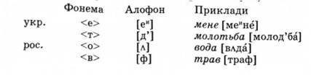
Prague linguistic school
Thus, the phoneme concept had originated in search for the theory of broad transcription. The work of the Prague school made it one of the fundamental elements of linguistic theory as a whole, and of scientific description and analysis of languages.

Slide 14
Prague linguistic school
Contribution to other areas of linguistics:
R. Jacobson studied the category of case in Russian and tried to discover the core semantic component of each case – he applied the method of phonological oppositions to grammatical categories
developed functional approach - studied functions of language and functional styles
Vilém Mathesius’ functional sentence perspective (theme and rheme) as opposed to formal division into syntactical members

Slide 15
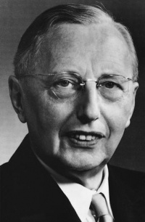
Louis Hjelmslev’s glossematics
Glossematics, system of linguistic analysis based on the distribution and interrelationship of glossemes, the smallest meaningful units of a language—e.g., a word, a stem, a grammatical element, a word order, or an intonation.
Danish scholar Louis Hjelmslev (1899–1965) and his collaborators were strongly influenced by the work of Ferdinand de Saussure.

Slide 16
Louis Hjelmslev’s glossematics
Glossematics is, strictly speaking, not a linguistic theory. Without relying on any specific language it constructs a system which seeks to establish a universal standard defining the necessary and sufficient conditions of language.

Slide 17

Louis Hjelmslev’s glossematics
1. Like Ferdinand de Saussure, Hjelmslev took the position that language is arbitrary in relation to the real world.
Why is a tree called “tree”?
2. Not all languages name things in the same way
(e.g. colours)
Words are signs and as such do not refer to the real world, but rather express our sense of it.

Slide 18
Louis Hjelmslev’s glossematics
Hjelmslev's ultimate goal with glossematics was to abstract what is common to all languages.
Thus he compares the phrases ‘jeg véd det ikke’, ‘je ne sais pas’, and ‘I don't know’ in Danish, French, and English respectively and suggests that although constructed differently they can all be said to share a single thought or ‘purport’ (meaning, sense).

Slide 19
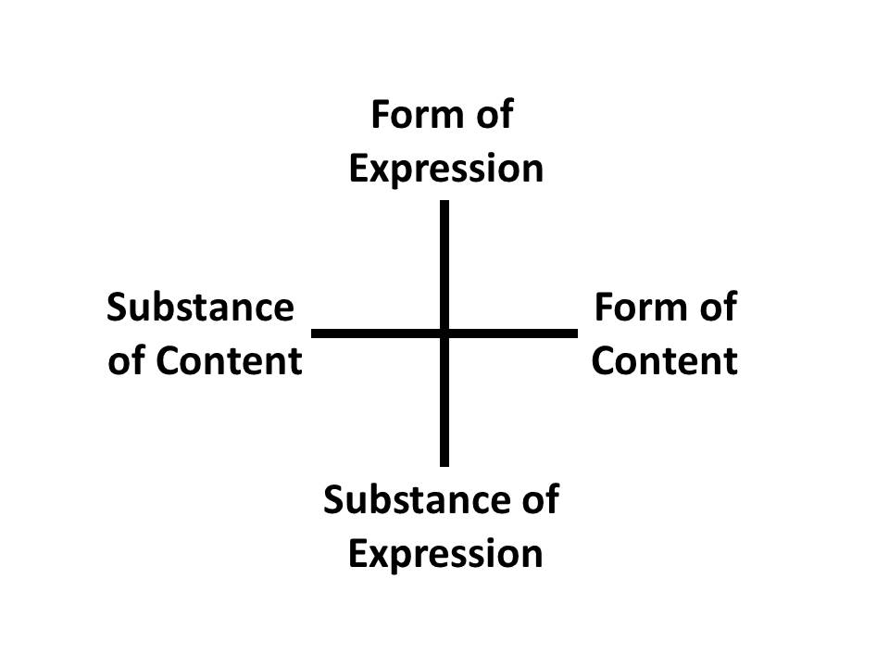
Louis Hjelmslev’s glossematics
As a process purport is equivalent to substance, as though the intent of a particular statement is like clay that can be moulded into a variety of different forms.
But, looked at from a system point of view, it does not have an independent existence—it can only be a substance insofar as it has form.
Thus, in addition to content as substance, there is always a content-form as well that is independent of the content and forms it into a content substance.

Slide 20
Louis Hjelmslev’s glossematics
The shape of a building is independent of the materials used to build it; but it is also constrained by those materials, in that there are only certain things concrete and steel can be made to do.
Hjelmslev recognizes this and accounts for it in
his system by adding a dimension of expression, again distinguishing system and process
within it.
As process, expression refers to the acquired limits in the range of references of particular words (as he points out, the Welsh ‘glas’ has a greater range of reference than English ‘blue’); as system, he notes that the same sound can have different meanings in different languages (‘got’ in English sounds the same as ‘Gott’ (god) in German, but doesn't mean the same thing).
Thus expression-purport and content-purport must be seen as independent of each other.

Slide 21
Louis Hjelmslev’s glossematics
Content plane – semantics and grammar
Expression plane – phonology
Form is interrelation of elements
Independence of content from expression
Content analysis must be independent of extra-linguistic existential criteria, and expression analysis (phonology) must be independent of (assumed extra-linguistic) phonetic criteria.

Slide 22
Louis Hjelmslev’s glossematics
Relations between elements, not the elements themselves are the object of a science
Saussurean ideal of linguistics as an autonomous science, not dependent on any other discipline.

Slide 23
Louis Hjelmslev’s glossematics
The two planes (content and expression) are analysable into ultimate constituents:
MARE
plane of expression: /m/+/Ɛ/+/Ə/ or m+a+r+e
plane of content: ‘horse’ + ‘female’ + ‘singular’
These planes are not isomorphous, as there is no connection between the individual phonemes or letters and the minimal elements of content.
But both planes are to be analysed in an analogous way and they are equivalent in a language system.

Slide 24
Louis Hjelmslev’s glossematics
This claim to equivalence between the two planes was criticized most, as differences in expression are independently observable in a language and belong to a strictly limited field, whereas differences in semantic content (which is unlimited) are only revealed through differences in expression in a language

Slide 25
American descriptive linguistics (1920s-1950s)
During the 1920s descriptive linguistics received wide recognition in US universities.
1924 the Linguistic Society of America was founded, with its periodical Language
Outstanding representatives: Franz Boas, Edward Sapir and Leonard Bloomfield

Slide 26
American descriptive linguistics (1920s-1950s)
arose from the pragmatic necessity to study mostly preliterate languages of America
prepared descriptive accounts of native languages of America
In many cases the linguists were learning the languages at the same time as they were analysing them >>>>
>>>>> heavy emphasis on “discovery procedures”, so that linguistic theory was virtually required to specify the operations by which a language was to be analysed
focus on synchronic studies caused by linguistic practice (the teaching of language) and the material from North American Indian languages

Slide 27
American descriptive linguistics (1920s-1950s)
Language is an aggregate of speech utterances which are the object of research
focus on the rules of the scientific description (hence the name) of texts
study of the organization, the arrangement and
classification of text elements
formalization of analytical procedures in the area of phonology and morphology (the development of principles for studying language at different levels, of distributive analysis, and of the method of immediate constituents)

Slide 28
American descriptive linguistics (1920s-1950s)
Sapir: ethnolinguistics | Bloomfield : mechanist linguistics
broader treatment of language: language is deeply connected with every sphere of human life | drew on behaviorist or mechanist psychology: mental images, feelings and the like are merely popular terms for various bodily movements speech communication as a series of stimuli and responses
studied the ways in which language and culture influence each other, and he was interested in the relation between linguistic differences and differences in cultural world views. | mechanist interpretation of science, concentrating on methodology and formal analysis
 | Major work: “Language” (1933)

Slide 29
American descriptive linguistics (1920s-1950s)
the two fundamental units of description: phoneme and morpheme
distinction between a speech sound and a phoneme is that between a member and a class
terms:
phone – phoneme – allophone
morph – morpheme – allomorph
снег – снеговик - снежный

Slide 30
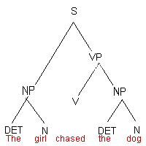
American descriptive linguistics (1920s-1950s)
Sentence structure is set out in terms of immediate constituent analysis.
Syntax is extension of
morphology.

Slide 31
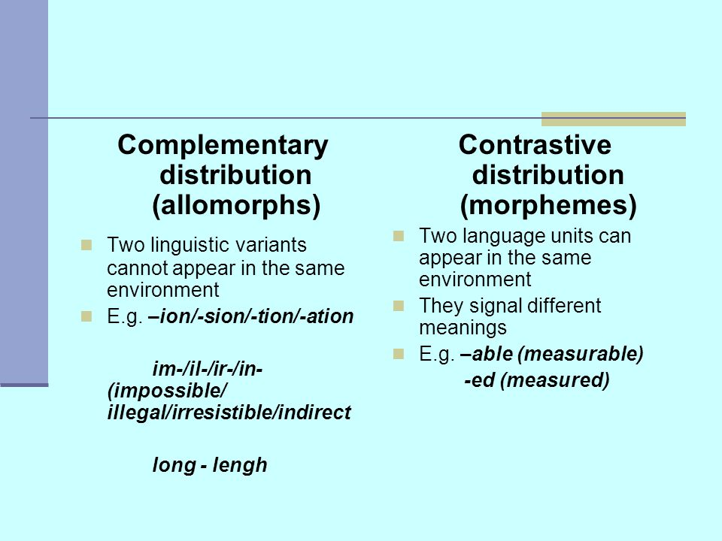
American descriptive linguistics (1920s-1950s)
Distribution analysis

Slide 32
American descriptive linguistics (1920s-1950s)
Lack of attention to the content plane of language, as well as to the paradigmatic aspect of language, did not permit descriptivists sufficiently fully and correctly to interpret language as a system.
There was also no consistent philosophical basis.
The overcoming of descriptivism is connected with sharp criticism of its methodological basis (in particular, its underestimation of the explanatory aspects of science) from the viewpoint of the theory of the generative grammar of language.

Slide 33
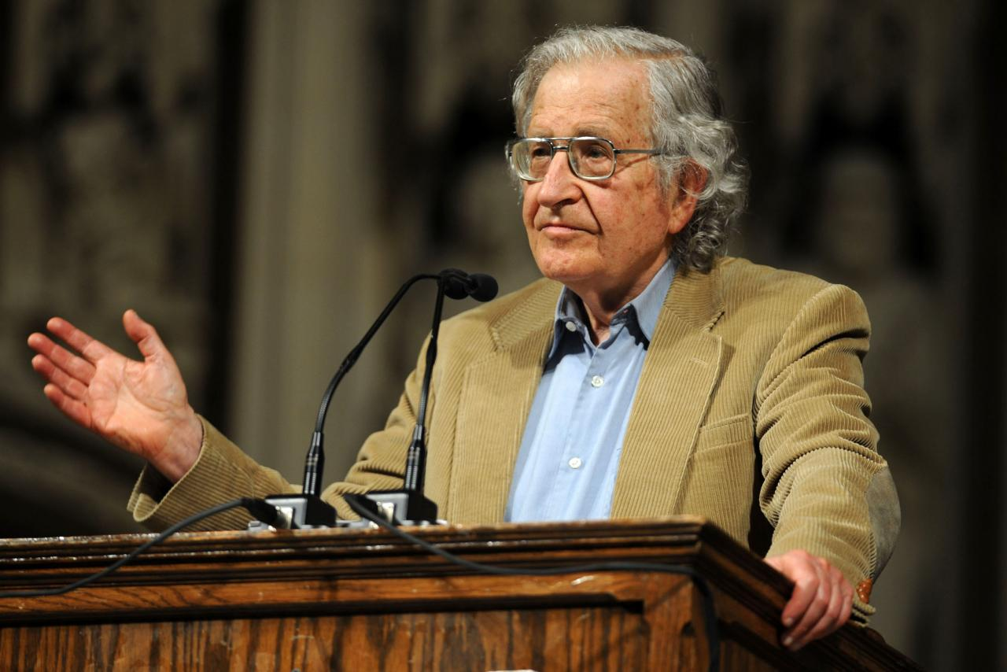
Noam Chomsky’s generative grammar
Noam Chomsky (1928), an American linguist, philosopher, cognitive scientist, historian, logician, social critic, and political activist.
Chomsky is among the most quoted authors in the world (among the top ten and the only living person on the list).

Slide 34
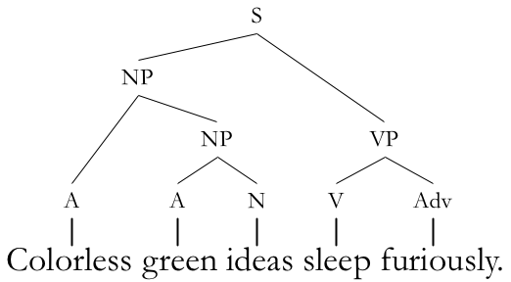
Noam Chomsky’s generative grammar
“A generative grammar of, say, English is an attempt at providing a fully explicit and mechanical statement of the rules governing the construction of English sentences. That is, the rules of the grammar must tell us exactly what can be counted as a grammatical sentence of English, while excluding everything that is not a sentence of English."
(R.L. Trask and Bill Mayblin, Introducing Linguistics, 2000)

Slide 35

Noam Chomsky’s generative grammar
Chomsky’s universal grammar
grammar is an innate body of knowledge possessed by language users, often termed Universal Grammar (UG)
syntactic knowledge is at least partially inborn - children need only learn certain parochial features of their native languages
the capacity to understand and produce language that the human has and the cat lacks is the language acquisition device (LAD), and one of the tasks for linguistics should be to determine what the LAD is and what constraints it imposes on the range of possible human languages. The universal features that would result from these constraints constitute 'universal grammar’
Language is not learnt , it grows
assisted by LAD

Slide 36
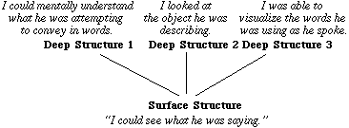
Noam Chomsky’s generative grammar
Chomsky’s transformational generative grammar
language consists of both deep structures and surface structures
Transformational grammar is a generative grammar (which dictates that the syntax, or word order, of surface structures adheres to certain principles and parameters) that consists of a limited series of rules, expressed in mathematical notation, which transform deep structures into well-formed surface structures. The transformational grammar thus relates meaning and sound.

Slide 37
Noam Chomsky’s generative grammar
Chomsky’s transformational generative grammar
But the fundamental reason for the inadequacy of traditional grammars is a more technical one. Although it was well understood that linguistic processes are in some sense "creative," the technical devices for expressing a system of recursive processes were simply not available until much more recently. In fact, a real understanding of how a language can (in Humboldt's words) "make infinite use of finite means" has developed only within the last thirty years, in the course of studies in the foundations of mathematics.
“Aspects of the Theory of Syntax”

Slide 38
Noam Chomsky’s generative grammar
Chomsky distinguished between competence and performance.
He argued that errors in linguistic performance were irrelevant to the study of linguistic competence (the knowledge that allows people to construct and understand grammatical sentences). Consequently, the linguist can study an idealised version of language, greatly simplifying linguistic analysis.

Slide 39
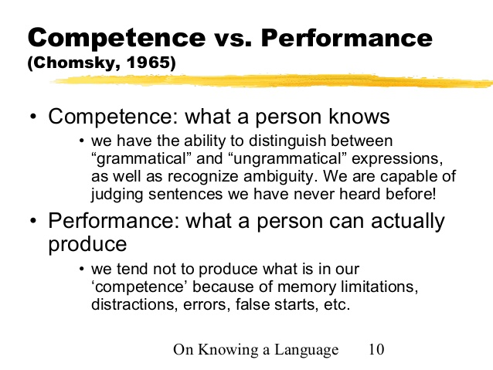
Noam Chomsky’s generative grammar

Slide 40
Noam Chomsky’s generative grammar
Types of grammar
Chomsky distinguished between grammars that achieve descriptive adequacy and those that go further and achieve explanatory adequacy.
A descriptively adequate grammar for a particular language defines the (infinite) set of grammatical sentences in that language; that is, it describes the language in its entirety.
A grammar that achieves explanatory adequacy gives an insight into the underlying linguistic structures in the human mind; that is, it does not merely describe the grammar of a language, but makes predictions about how linguistic knowledge is mentally represented.

Slide 41
Noam Chomsky’s generative grammar
Real insight into the structure of individual languages can only be gained through comparative study of a wide range of languages, on the assumption that they are all cut from the same cloth (they rely on a dedicated and innate mental structure).

Slide 42
Neo-Humboldtian theories
Leo Weisgerber (1899-1985), a German linguist who specialized in Celtic languages
„Von den Kräften der deutschen Sprache“ (“The Powers of the German Language”)
Each language represents a world view, a world construction (Weltbild) and is characterized by an inner form. This form is carried primarily in lexicon. To understand a language in its specificity, one must reconstruct not only its form, but the semantic fields, the word fields that make up its contents.

Slide 43
Neo-Humboldtian theories
Central aspect
valorization of one’s mother tongue, whose specificities are bound up with one’s most profound values
Learning other languages can not be of much help in expanding one’s horizons, since one learns them through the mother tongue and they remain marginal to it.
The focus is not on opening up possibilities of thought through exposure to non-familiar ways of organizing experiences but on deeper understanding of one’s own language and culture.

Slide 44
Neo-Humboldtian theories
In vocabulary Weisgerber considers the high number of abstract colour terms in German and other West-European languages as a sign of their greater appropriateness for abstract thought.
The syntax of a German sentence requires that the speaker hold a complex pattern of relations in mind.
High valorization of German and the emphasis on the mother tongue made Neo-Humboldtian ideas attractive to the Third Reich. The regime saw their ideas as a new way of thinking which rejected the cold science of old historical linguistics and sought to aid actively in the self-realization of the German nation.

Slide 45
Neo-Humboldtian theories
American ethnolinguistics
"It is peculiarly important that linguists, who are often accused, and accused justly, of failure to look beyond pretty patterns of their subject matter, should become aware of what their science may mean for the interpretation of human conduct in general. Whether they like it or not they must become increasingly concerned with the many anthropological, sociological, and psychological problems which invade the field of language.“
Edward Sapir

Slide 46
Neo-Humboldtian theories
American ethnolinguistics
No two languages are ever sufficiently similar to be considered as representing the same social reality. The worlds in which different societies live are distinct worlds, not merely the same world with different labels attached.
Edward Sapir

Slide 47
Neo-Humboldtian theories
Edward Sapir
believed that language shapes human perception and directs human behavior. From his view, understanding a culture is impossible without understanding the historical development of that culture’s language
language is not static, it constantly changes ("Language Drift“) Some parts of language change quickly while some are much slower. As reality changes, so does the language.
conversely, due to the change in language, reality changes as well. We think, hear, see, and behave through our language. Language serves as a certain filter through which we experience and interpret reality. Every culture has its own language, or set of filters through which it predisposes its members to certain kinds of experience and thinking. Without language, it is difficult to imagine human life at all.

Slide 48
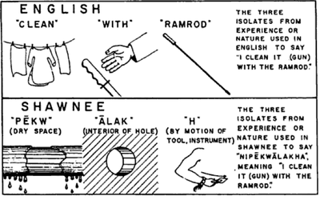
Neo-Humboldtian theories
Linguistic relativism, also known as the Sapir-Whorf Hypothesis
Language is not just a list of words and grammar structures that give us rules for how to express our ideas properly, but that language essentially defines how we see things, and influences our cognitive processes.
Whorf's illustration of the difference between the English and Shawnee gestalt construction of cleaning a gun with a ramrod:

Slide 49
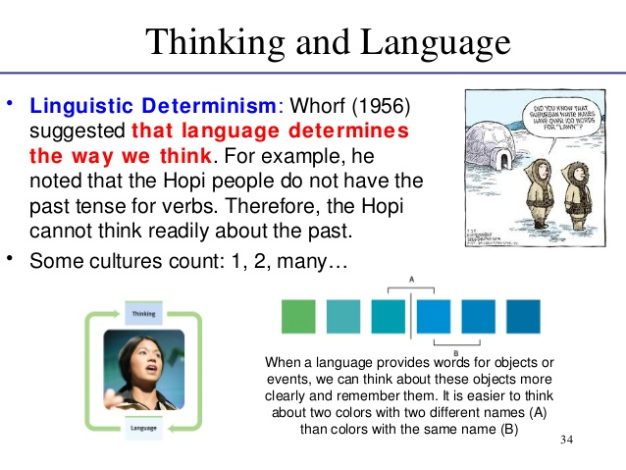
Neo-Humboldtian theories

