Slide 1
Modern trends in linguistics

Slide 2
Modern trends in linguistics
Cognitive linguistics.
Functional grammar.
Text linguistics.
Communicative linguistics.

Slide 3
Linguistics in the 20th century
comparative linguistics
genesis
structural linguistics
system
communicative
linguistics
function

Slide 4

Cognitive linguistics
Cognitive linguistics is an approach to the analysis of natural language that originated in the late 1970s and early 1980s in the work of US linguists George Lakoff, Ron Langacker, and Len Talmy, and that focuses on language as an instrument for organizing, processing, and conveying information.
It emerged as a reaction against the dominant generative paradigm.

Slide 5
Cognitive linguistics
language is not autonomous, it is embedded in the overall cognitive capacities of man; there is no autonomous linguistic faculty in human mind
the formal structures of language are studied as reflections of general conceptual organization, categorization principles, processing mechanisms, and experiential and environmental influences
linguistic knowledge involves not just knowledge of the language, but knowledge of the world as mediated by the language
knowledge of language arises out of language use; the study of language is the study of language use

Slide 6
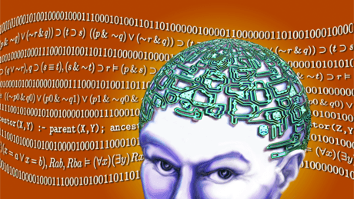
Cognitive linguistics
our interaction with the world is mediated through informational structures in the mind
natural language is a means for organizing, processing, and conveying that information.
language is seen as a repository of world knowledge, a structured collection of meaningful categories that help us deal with new experiences and store information about old ones.

Slide 7
Cognitive linguistics
Three fundamental characteristics of Cognitive Linguistics:
the primacy of semantics in linguistic analysis (the primary function of language is categorization, it involves meaning)
the encyclopedic nature of linguistic meaning (world knowledge is associated with linguistic forms)
the perspectival nature of linguistic meaning (the world is not objectively reflected in the language: the categorization function of the language imposes a structure on the world rather than just mirroring objective reality)

Slide 8
Cognitive linguistics
Generative linguistics vs Cognitive linguistics
Generative linguistics: how knowledge of language can be acquired through a cognitive theory of learning
Cognitive linguistics:
how natural language contributes to our knowledge of the world
there can be no knowledge without the existence of a mental representation that has a constitutive, mediating role in the epistemological relationship between subject and object.

Slide 9
Cognitive linguistics
develops a rich conception of grammar that reflects fundamental cognitive abilities: the ability to form structured conceptualizations with multiple levels of organization, to conceive of a situation at varying levels of abstraction, to establish correspondences between facets of different structures, and to construe the same situation in alternate ways

Slide 10
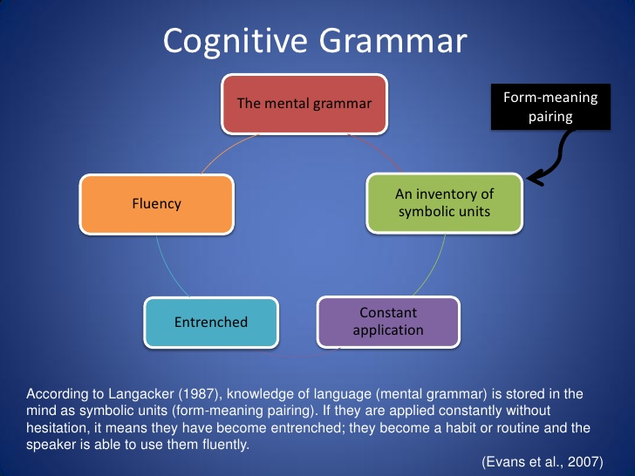
Cognitive linguistics

Slide 11

Cognitive linguistics
Language does not "represent" meaning; it prompts for the construction of meaning in particular contexts with particular cultural models and cognitive resources. The speaker is guided along the same mental paths, being prompted to perform complex cognitive operations. Thus, a large part of cognitive linguistics centers on the creative on-line construction of meaning as discourse unfolds in context.

Slide 12
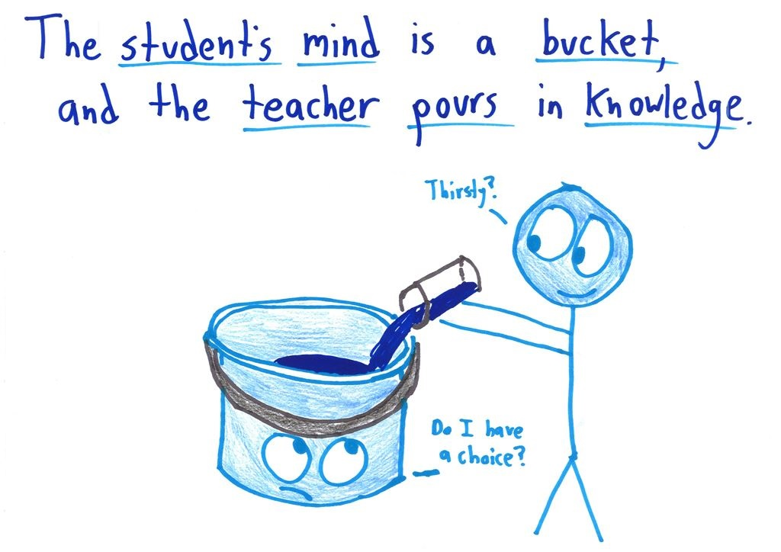
Cognitive linguistics
study of metaphor and metonymy as powerful conceptual mappings at the very core of human thought, important not just for the understanding of poetry, but also science, mathematics, religion, philosophy, and everyday speaking and thinking
Metaphor is not just a figure of speech!
In the scheme of evolution, metaphor, based on human experience and neural connections to our embodied sensations, actions, and emotions, is what creates the possibility of 'abstract' reasoning, scientific and mathematical thought, philosophical speculation, in other words language and culture quite generally.
Metaphor gives the mind the power that it has.

Slide 13
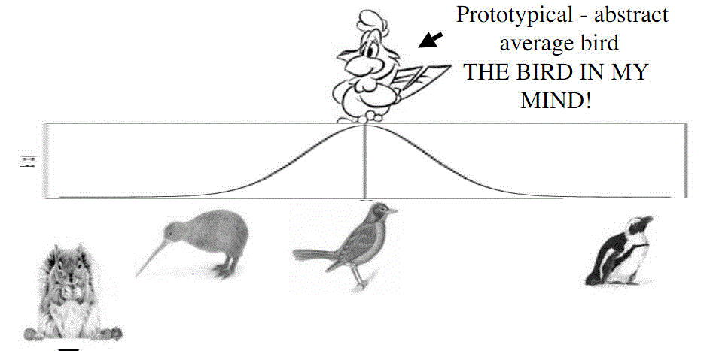
Cognitive linguistics
Prototypes and concepts
Prototypes are an idealized, internalized conceptualization of an object reality.

Slide 14
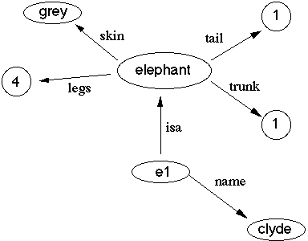
Cognitive linguistics
Frame semantics
Frame semantics is a theory of linguistic meaning developed by Charles J. Fillmore.
It relates linguistic semantics to encyclopaedic knowledge.
The basic idea is that one cannot understand the meaning of a single word without access to all the essential knowledge that relates to that word.
A semantic frame is a collection of facts that specify "characteristic features, attributes, and functions of a denotatum, and its characteristic interactions with things necessarily or typically associated with it”.

Slide 15
Functional grammar
Functional Grammar (FG), as developed by the Dutch linguist Simon Dik and others, is a general theory of the organization of natural language. FG seeks to be a theory which is 'functional' in at least three different, though interrelated senses:
It takes a functional view on the nature of language;
It attaches primary importance to functional relations at different levels in the organization of grammar;
It wishes to be practically applicable to the analysis of different aspects of language and language use.

Slide 16
Functional grammar
The following standards of adequacy are of particular importance for the theory of FG:
TYPOLOGICAL ADEQUACY: the theory should be formulated in terms of rules and principles which can be applied to any type of natural language.
PRAGMATIC ADEQUACY: what the theory says about a language should be such as to help us understand how linguistic expressions can be effectively used in communicative interaction.
PSYCHOLOGICAL ADEQUACY: what the theory says about a language should be compatible with what is known about the psychological mechanisms involved in natural language processing.

Slide 17
Functional grammar
In FG, functional notions play essential and fundamental roles at different levels of grammatical organization.
Three types or levels of functions are distinguished:
SEMANTIC FUNCTIONS (Agent, Patient, Recipient, etc.) which define the roles that participants play in states of affairs.
SYNTACTIC FUNCTIONS (Subject and Object) which define different perspectives through which states of affairs are presented in linguistic expressions.
PRAGMATIC FUNCTIONS (Theme and Tail, Topic and Focus) which define the informational status of constituents of linguistic expressions.

Slide 18
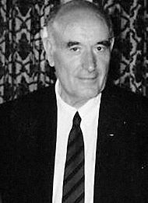
Functional grammar
Alexander Bondarko (1930-2016)
“Functional Grammar: A Field Approach”
the author of the theory
of Functional Semantic Fields (FSF)

Slide 19
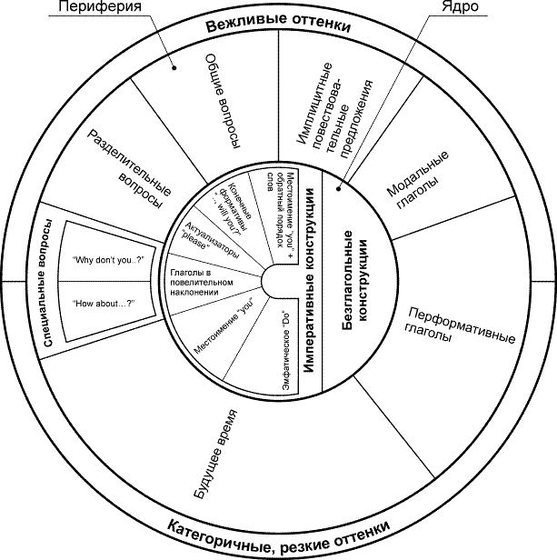
Functional grammar
FSF is a system of language units of various levels (lexical, morphological, syntactical) which perform the same function on the basis of their common categorial content (modality, temporality, possessiveness, aspectuality, intensity etc.)
ФСО спонукальності

Slide 20
Text linguistics
Text linguistics is a branch of linguistics concerned with the description and analysis of extended texts (either spoken or written) in communicative contexts.
Text linguistics overlaps considerably with discourse analysis.

Slide 21
Text linguistics
“... it has become obvious to a growing number of linguists that the study of the syntax of isolated sentences, extracted without natural context from the purposeful constructions of speakers is a methodology that has outlived it usefulness”.
Thomas Givon, a US linguist
“There are certain types of sentences which we cannot make sense of, either syntactically or semantically, without examining them with respect to a discourse context”
Norman Gary a US linguist

Slide 22
Text linguistics
Approaches to the study of texts
text grammar (Van Dijk) aims to establish a model with which the grammatical structures of texts can be described (quite similar to Chomsky’s transformational approach).
text linguistics is devoted to describing how texts are created and understood and in so doing studies the defining properties of texts - what constitutes their textuality or texture (Crystal).
discourse analysis (Renkema, Schiffrin) traditionally analyses chiefly written texts. However, it seems that it is very difficult to define “discourse” precisely - Schiffrin (1994) for example says that discourse analysis “... is one of the most vast, but also least defined, areas in linguistics”.

Slide 23

Text linguistics
A text is defined as a communicative occurrence which meets seven standards (principles) of textuality:
cohesion,
coherence,
intentionality,
acceptability,
informativity,
contextuality
and intertextuality.

Slide 24
Text linguistics
Cohesion
M.Halliday , R.Hasan “Cohesion in English” (1976)
“The concept of cohesion accounts for the essential semantic relations whereby any passage of speech or writing is enabled to function as text”
Categories of cohesion provide a practical means for describing and analysing texts. They are explicitly expressed in a text:
reference,
substitution,
ellipse,
conjunction
lexical cohesion (synonymy, antonymy, collocation).

Slide 25
Text linguistics
Coherence
Coherence is probably the main component of any form of textual study because if a text is not fully understood a ‘good’ text was not produced.
What makes a text “coherent”?
What makes some texts “acceptable” and others “unacceptable”?
A coherent text has an underlying logical structure that acts to guide the reader through the text so that “it ‘sticks together’ as a unit and creates the feeling that a text hangs together, that it makes sense, and is not just a jumble of sentences.

Slide 26
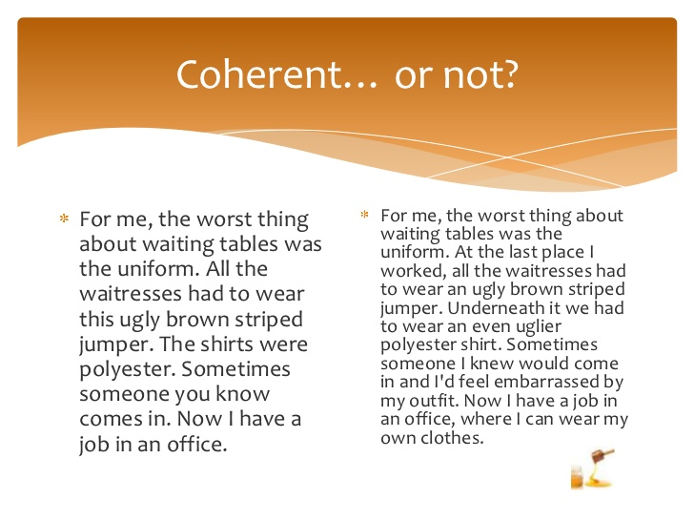
Text linguistics

Slide 27
Text linguistics
Intentionality and acceptability are generally regarded as a ‘pair’ of principles.
In any text there is a producer who has the intention to produce a sound piece of information to a receptor. The receptor needs to be willing to accept the proffered text as a communicative text.
In order to do this both producer and addressee have to adhere to the pragmatic cooperative principle which states that one has to make the maximum effort to enable a piece of intended communication to be a success.

Slide 28
Text linguistics
Informativity has to do with the way in which parts of the text have communicative value.
Which is more informative?
a man with a golden gun him (pronoun)

Slide 29
Text linguistics
Contextuality focuses on the role the context plays in any form of communication. I
In every situation in which language is used, the quality and effect of the communication is determined by the contextual knowledge shared by the participants.
This aspect of language use is studied by pragmatics
and sociolinguistics.
Pragmatics focuses on what the participants in a discourse intend to accomplish through the use of the language (what speech act is performed in a given setting).
Sociolinguistics aims to determine the role knowledge of the
participants (as human beings and in the environment they function as such) plays in the success of a communicative occurrence.

Slide 30

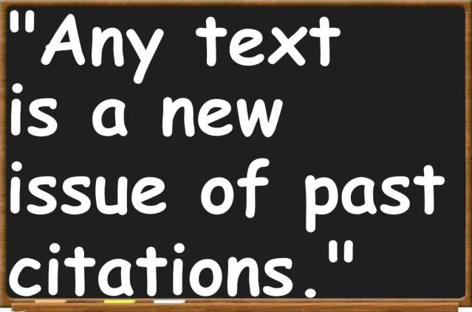
Text linguistics
Intertextuality means that the formation and understanding of one text will be influenced by the structure of another text similar to it.

Slide 31

Text linguistics
Text linguistics is a kind of umbrella discipline which makes the study of the different disciplines of linguistics more relevant.
Principle of textuality | Linguistic sub-disciplines
Cohesion | Syntax Semantics Morphology Phonology
Coherence | Semantics Cognitive linguistics
Intentionality | Pragmatics
Acceptability | Pragmatics
Informativity | Semantics Syntax
Contextuality | Pragmatics Sociolinguistics
Intertextuality | Literature theory

Slide 32
Communicative linguistics
Text linguistics and discourse analysis are directly connected with communicative linguistics which studies speech communication, involving the following components:
speaker
addressee
message
context
specifics of contact
message code (means)

Slide 33
Communicative linguistics
Paul Grice (1913-1988), British philosopher of language
Maxims of effective communication
Maxim of Quality
Supermaxim:
Try to make your contribution one that is true
Submaxims:
Do not say what you believe to be false.
Do not say that for which you lack adequate evidence.
Maxim of Quantity
Make your contribution as informative as is required (for the current purposes of the exchange).
Do not make your contribution more informative than is required.
Maxim of Relevance
Be Relevant
Maxim of Manner
Supermaxim:
Be clear and keen
Submaxims:
Avoid obscurity of expression.
Avoid ambiguity.
Be brief.
Be orderly.

Slide 34
Communicative linguistics
Speech-act theory is a subfield of pragmatics concerned with the ways in which words can be used not only to present information but also to carry out actions.
As introduced by Oxford philosopher J.L. Austin (“How to Do Things With Words”, 1962) and further developed by American philosopher J.R. Searle, speech-act theory considers the levels of action at which utterances are said to perform:
Locutionary Acts
Illocutionary Acts
Perlocutionary Acts

Slide 35
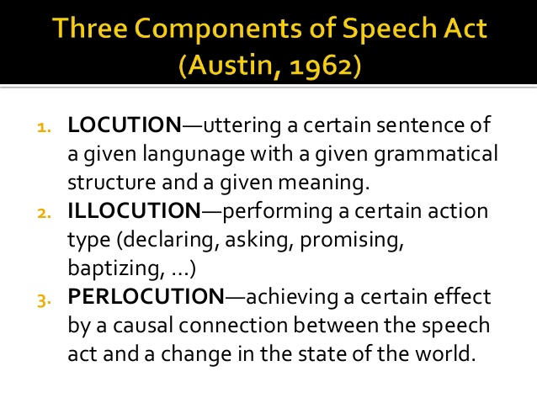

Slide 36
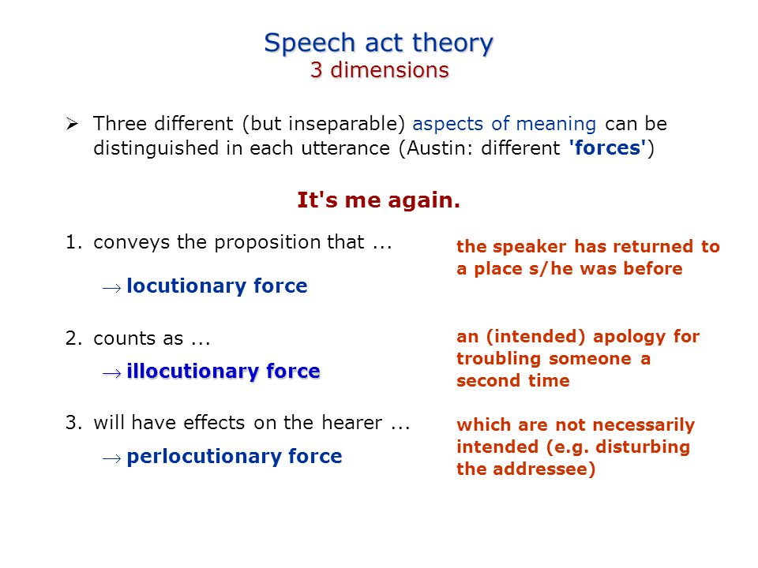
Communicative linguistics

Slide 37
Communicative linguistics
Communicative competence refers to both the knowledge of a language and the ability to use it effectively.
The concept of communicative competence (a term coined by linguist Dell Hymes in 1972) grew out of resistance to the concept of linguistic competence introduced by Noam Chomsky (1965). Most scholars now consider linguistic competence to be a part of communicative competence.

