Slide 1
FORMATION OF NATIVE AMERICAN IDENTITY IN THE 20-TH CENTURY
Oksana Shostak
National Aviation University
October, 19, 2018
oshostak@ukr.net

Slide 2
Why National Identity?
The last quarter of the 20 th century is indicated by a number of national renaissances that have taken place in many countries of the world. The basis of this phenomenon, scientists believe that growth of society social mobility, technological innovation and the flow of information, to which humanity was not psychologically ready. In such conditions, only ethnic becomes an effective protective mechanism for humans, only ethnic unity holds a stable society, the individual's belonging to which, under conditions of constant changes, does not change.

Slide 3
The Need for National Identity
Increased attention to national identity, the need for the consolidation of ethnic communities, the attempt to create a national ideal and national idea in the new social conditions, along with the desire to isolate from mass national mythology, culture, history and customs - all this components are a protective reaction to the increased unification of spiritual and material culture in the conditions of the 20th century globalization.

Slide 4
Native American Identity
The movement toward national identity at the beginning of the 21st century acquired the character of a world trend that affected societies of many countries, regardless of their level of development. The concept of identity originates from the Latin word "identifico", which means "I identify". The concept of the identity of the indigenous peoples of North America is an extremely controversial phenomenon from a philosophical point of view, but it acquires even greater multi-vectority in the political context. In the modern world, the question of which people should be considered an indigenous people, and what are the criteria that outline the national identity, are extremely acute. An important component of the national individual awareness is the ability to create human relations between representatives of different ethnic communities.

Slide 5
Who is Indigenous?
The debate around a clear definition of the standards of concept "Indigenous" versus self-identification adds an even greater urgency to the dilemma of constructing a Native American identity. Present time is marked by researches in the field of the so-called "anticolonial identity", which are caused by the danger of conflicts of ethnocultural worlds.

Slide 6
Simon Ortiz (Acoma Pueblo)
GREATEST BELIEVERS GREATEST DISBELIEVERS
To believe or not to believe,
this was the question.
And THE ANSWER.
Asked and answered and believed
by the greatest believers
and disbelievers the world
has ever known.
Where are the Indians?
Where are the real
Indians?
There are no Indians.
There are no real Indians.
There were never any Indians.
There were never any Indians.
There were never any real Indians.
You mean... you mean, there were never any Indians?
No real Indians?
None.
Never.

Slide 7
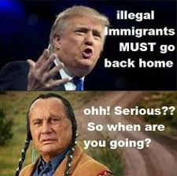
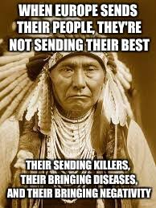
Who is Indigenous?

Slide 8
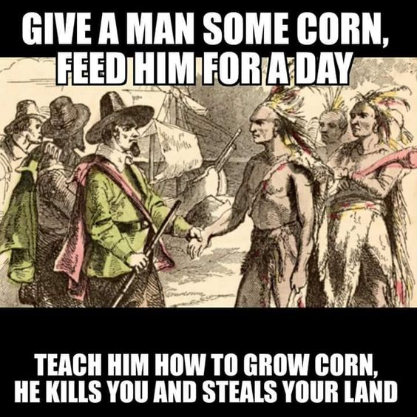
Is White Culture Mainstream?
American society often deliberately registers opposition between white and black identity margining this way Hispanics, Native Americans and Asian Americans, so everybody is compared only to the mainstream white group.

Slide 9
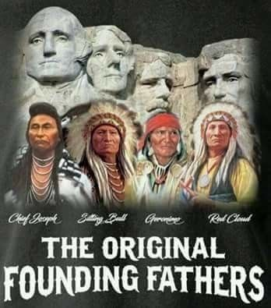
Whose Land is This?

Slide 10
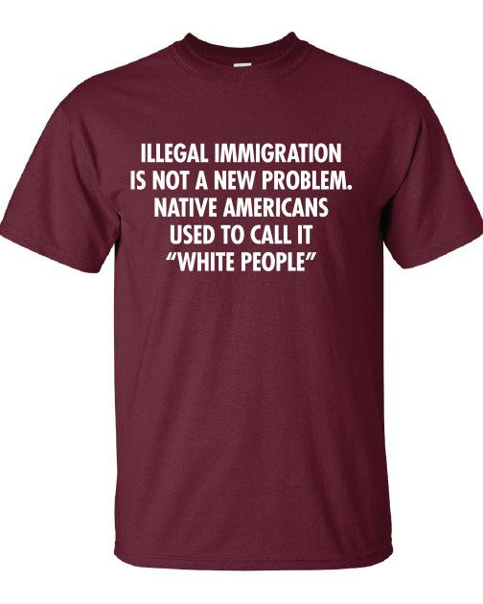
Cultural interaction of different cultures, reserves the right to be "non-transparent", exemplifies a new idea of order and chaos in the world and is a kind of attempt to find a solution to the postmodern situation [Madina Tlostanova].

Slide 11
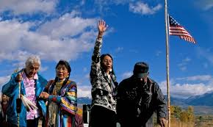
“Hostile Otherness”
This unknown until recently, and thought to be hostile ‘otherness’, now is considered fashionable. And for the sake of convenience it is uploaded to the mainstream, in addition to formal legitimization, it must be "packaged in convenient consumer packaging", this way it is not only an easy assignment, but it is safe (as already known), predictable and "not completely different" [1:122]. Thus the culture of consumption seemingly blurs the boundaries leveling any identity.

Slide 12
Native American Stereotypes

Slide 13
Native American Stereotypes
An important place is occupied by stereotypes and commercialization. In this regard, indicative for American society is a latent racism that demonstrates the commercial application of such insulting for Native America words like "Redskins," "Indians," "squaw", "papus," "you, cougars" etc. Sports teams and advertising of various products use images as Indian Mascot, naming the machines by the names of nations (Cherokee, Dakota, Winnebago). This evokes each time historical stereotypes of Indian barbaric savagery, sexual availability of Indian women and Indian innate laziness.

Slide 14
Indian Mascots
, Jesus Christ is also a bad idea for Mascot because Christians Researchers emphasize that Indian Mascots usage is an unworthy replication of stereotypes, but also direct humiliation of Native Americans. According to Young Man, if any of the leading sports teams would use anything associated with Muslims, then this area would immediately covered with the wave of acts of terrorare not very tolerant as well. "Indians love basketball, but we don’t set up camp in the ballpark! ... Hey, if the Atlanta Braves think that using Indian as Mascot is simply a harmless fun, why not have them dress up some white guy in a three-piece suit and have him shuffle around a mobile home parked in the middle of the outfield every time their team scores a hit? Or how about changing the names of a few of these sports teams? Why not have the Atlanta or the Kansas City Caucasians or the Chicago Negroes, The Washington Jews or New York Rednecks?"

Slide 15
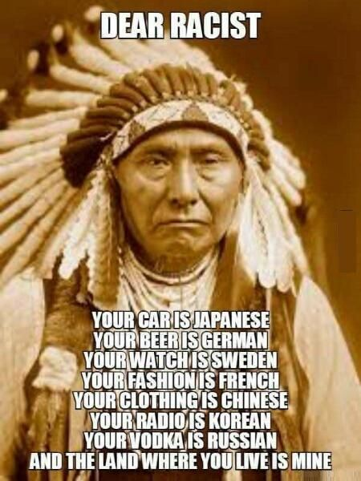
Native American Stereotypes

Slide 16
Cultural consumption
Another type of Indian identity "cultural consumption" is represented by very common worldwide game in Indians, which has historical roots in the US history. During the famous Boston Tea Party, when the tea packs were thrown into the sea as a symbol of opposition to British Laws, the participants of the action were dressed like Indians [5]. S.Rassel writes about spreading Indian game types, while whites choose to play Indians, rather than make attempt to understand the culture and customs of the American Indians. "In Europe grown people go prancing through the woods half naked, drumming at all hours, and building tipis in places where tipis would manifestly make no sense. Tipis were good shelter where wood was scares: American Indians did not build tipis in the woods. Many Americans believe they are the grandchildren of Cherokee (why does it always have to be Cherokee?) royalty, usually a princess, who came to them in a dream and told them to collect artifacts associated with Siouan peoples. At least Grandmother had a sense of humor"

Slide 17
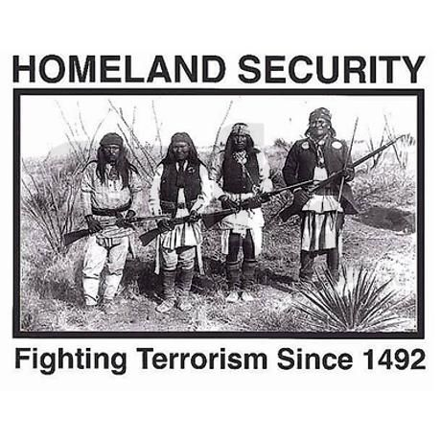

Slide 18
Racism
During the last 235 years of North American Indian policy toward Indigenous people, native people were systematically represented as those of a lower stage of development, unable savages. Anti-Indian terminology, imagery and behavior have achieved such a level of legitimacy that even representatives of other marginal groups do not perceive it as a manifestation of racism and even take part in it.

Slide 19
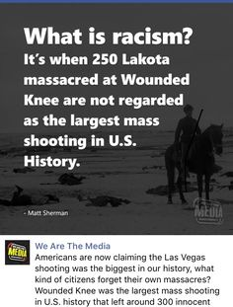

Slide 20
Who discover America?
According to Charles Mills, an attempt to build the myth of the stranger is rooted in the so called ‘discover of Americas’, since the first arrival of Columbus, although from a purely technical point of view, neither Columbus nor members of his team had never set foot on the land of the continent. And it was Columbus who started dichotomy of Indian perception in his letters. It is still vividly alive in the world’s cultural paradigm. At first Columbus addressed to the natives as to noble savages, children of nature, based on their nakedness, but as soon as they began to resist European attempts of colonization, they became cannibals which were divinely predestined to be destroyed or enslaved

Slide 21
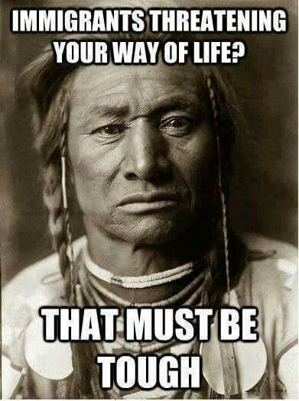

Slide 22
Is Eurocentrism Universal?
Since ancient times the option of "Self" is issued the notion of being "universal" while the barbarians were perceived not just as different, but as a violation of the "universal", which did not reach the desired development. Hence the concept of Eurocentric values were born, from this position the rest of the countries, peoples and cultures were perceived as immature, their development and progress had to implement the same principles and schemes that already were in existence in Europe.

Slide 23
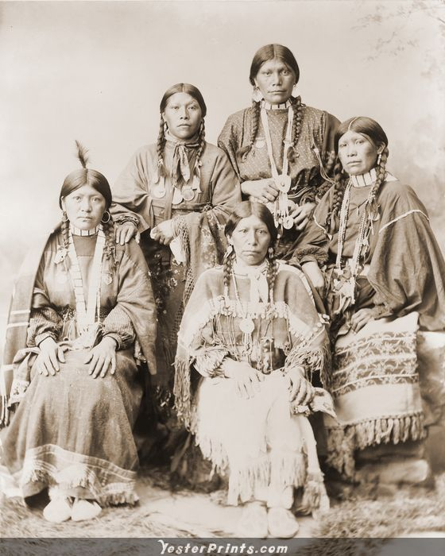

Slide 24
Literary Basis of Racism
Of course all of us read James Fennimore Cooper’s novels and grieved Uncas’ death as a symbol of decline of great nation. But is it really so? Mohicans are part of Algonquian nation still exists on the territory of Wisconsin where it was forced by European colonialists. Another classical literary reference to the indigenous people of the US land is found in Mobi Dick. Melville’s use of “Pequot” as the name of the ship anticipated the commercialization of Native names for vehicles, such as Jeep Cherokee and Dodge Dakota.

Slide 25
. Pequot is the name of virtual eliminated indigenous nation, as the result of the Pequot war of 1636-1637 and Treaty of Hartford, the major feature of this treaty was to outlaw the Pequot language and name. Any survivors would be referred in the future as Mohegans or Narragansett, forbidding the Pequot from regrouping as a tribe, and required that other tribes in the region submit all their inter-tribal grievance to the English and abide by their decisions. No Pequot town or settlement would be allowed.

Slide 26
It is interesting to mention that Cooper’s heroic Uncas was at the Pequot Massacre helping to slaughter them, as Mohegans and Narragansetts joined Masons and Puritans against the Pequots. Gradually the Pequot were able to reestablish their identity, but as separate tribes in separate communities.
A question might be raised: Is genocide a necessary precursor of branding American vessels and automobiles with the names of Indian nations? It is quite possible that Melville deliberately named Ahab’s doomed ship after the persecuted tribe; it was his way of warning to compatriots, his attempt to highlight and to excoriate colonialists’ and mid-19th century massacres of Native Americans and oppressions of other native people. This vessel symbol can be read as a state carrying diverse people and it is doomed under unwise leadership: Ahab refuses to end his pursuit of Mobi Dick no matter the cost of human lives including his own. This book might be interpreted as a jeremiad, prevention of the future failure of the country should it be so rigid, hating and self-righteous.

Slide 27
Modern-day American society in a way heeded that request, the end of 60-s was marked by the Native American Renaissance with such prominent Native American writers such as N.Scott Momaday, Leslie Marmon Silko, Louise Erdrich, Paula Gunn Allen, Gerald Vizenor, James Welch, Louis Owens, Linda Hogan, Simon Ortiz, Linda Boyden and many others. Their books are devoted to recovering indigenous identity. These labors are really necessary; they bear fruits to the whole society, they invite their readers into necessary discussion of the role natives played in the shaping of the modern world. Native American literary works illuminate the issues of nationhood, relationship and memory, citizenship and self-determination through particular native landscape, pretty often it is done through an ironic transnational framework. Writers, representatives of different indigenous nations reveal the peculiarities and determine the locales and ideas of nations, despite discourses of dominance that would preordain and reduce Native American experience to an urban/reservation dichotomy and normalize colonial conquest.

Slide 28
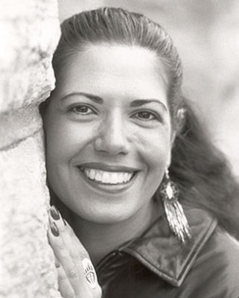
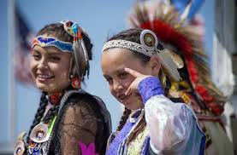

Slide 29
Nowadays Famous Native Americans
Demi Moore
is an American actress, filmmaker, former songwriter, and model.

Slide 30
Navarre Scott Momaday
(born February 27, 1934) — known as N. Scott Momaday — is a Native American author of Kiowa descent. His work House Made of Dawn was awarded the Pulitzer Prize for Fiction in 1969. Momaday received the National Medal of Arts in 2007 for his work that celebrated and preserved Native American oral and art tradition. He holds 20 honorary degrees from colleges and universities, and is a fellow of the American Academy of Arts and Sciences

Slide 31
Louise Erdrich
(born Karen Louise Erdrich, June 7, 1954) is an Ojibwe writer of novels, poetry, and children's books featuring Native American characters and settings. She is an enrolled member of the Turtle Mountain Band of Chippewa Indians, a band of the Anishinaabe (also known as Ojibwe and Chippewa)

Slide 32
Sherman Joseph Alexie, Jr.
(born October 7, 1966) is an American poet, writer, and filmmaker. Much of his writing draws on his experiences as a Native American with ancestry of several tribes, growing up on the Spokane Indian Reservation. He lives in Seattle, Washington.

Slide 33
Rose Marie "Tantoo" Cardinal
CM (born July 20, 1950) is a Canadian film and television actress.

Slide 34
John Bennett Herrington
(born September 14, 1958 in Chickasaw Nation) is a retired United States Naval Aviator and former NASA astronaut. In 2002, Herrington became the first enrolled member of a Native American tribe to fly in space. (William R. Pogue was of Choctaw ancestry and was a crewman aboard Skylab 4 in 1973–1974, but he was not an enrolled member of the Choctaw.)

Slide 35
Gary Paul Davis
(born March 1, 1969), better known by his stage name Litefoot, is a Native American rapper, actor, and the founder of the Red Vinyl record label. He also portrayed Little Bear in the movie The Indian in the Cupboard, and Nightwolf in Mortal Kombat Annihilation.

Slide 36
TNTHANK YOU FOR YOUR ATTENTION!

