Slide 1
Baudouin de Courtenay and Ferdinand de Saussure

Slide 2
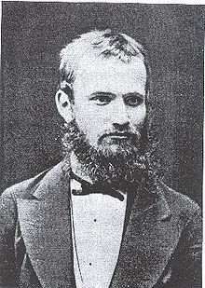
Baudouin de Courtenay and Kazan linguistic school
Baudouin de Courtenay (1845 –1929) was a Polish linguist and Slavist, best known for his theory of the phoneme and phonetic alternations.
For most of his life Baudouin de Courtenay worked at Imperial Russian universities:
Kazan, Tartu and St. Petersburg

Slide 3
Baudouin de Courtenay and Kazan linguistic school
established the Kazan school of linguistics in the mid-1870s
his work had a major impact on 20th-century linguistic theory, and it served as a foundation for the three major schools of phonology (Leningrad, Moscow and Prague)
developed synchronic linguistics, the study of contemporary spoken languages

Slide 4
Baudouin de Courtenay and Kazan linguistic school
Correlation between synchronic and diachronic language studies
Drawing upon Humboldt’s antinomy of stability and flexibility in the language, KLS scholars developed the study about dichotomy of dynamics and statics in the language.
“There is no immobility in the language, like in the whole of nature, everything lives, everything moves, everything changes. Calmness, pause, standstill is a seeming occurrence, and is a particular case of moving under condition of minimal changes. Language statics is just a particular case of its dynamics or rather cinematics”.
Baudouin’s student from St. Petersburg academician L.V. Tscherba called his teacher’s method “dynamic synchrony”.

Slide 5
Baudouin de Courtenay and Kazan linguistic school
Major scientific problems developed by KLS
strict distinction of a sound and a letter;
distinction of phonetic and morphologic word divisibility;
distinction of pure phonetic (anthropophonic) and psychic elements in the language;
distinction of changes taking place regularly a language and changes which used to happen in the history;
advantage of a living language examination;
importance of analyzing and dividing linguistic units according to their distinctive features;
aiming at theoretical generalizations, which are necessary for every real science.

Slide 6
Baudouin de Courtenay and Kazan linguistic school
Major achievements
Kazan linguists considered the language to be a constantly changing complicated system of heterogeneous units (phonetic, morphologic, syntactic, etc.).
Discovered key units of each linguistic level: a phoneme, a morpheme, a lexeme, a syntagma, etc.
Coined the term morpheme.
Drew distinction between dynamics and statics in language and between language and speech
Shaped the modern usage of the term phoneme
”the psychological equivalent of a speech sound”
ideal sound image in the speaker’s mind which represents their (perhaps imperfectly realized) intention in production
Advanced the theory of phonetic alternations. Distinguished between physiophonetic (phonological) and psychophonetic (morphophonological) alternations.

Slide 7
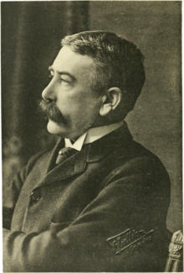
Ferdinand de Saussure
Ferdinand de Saussure (1857-1913),
Swiss linguist, a key figure in European linguistics at the turn of the century
Cours de linguistique générale (1916) – de Saussure’s lectures on linguistics
published by his pupils in Geneva
Its publication was compared to Copernican revolution

Slide 8
Ferdinand de Saussure
formalized and made explicit the two fundamental dimensions of linguistic study: synchronic and diachronic, both essential in any adequate course of linguistic study or linguistic instruction
distinguished the linguistic competence of the speaker (language) and the actual phenomena or data of linguistics (speech)
any language must be described synchronically as a system of interrelated elements, lexical, grammatical and phonological, and not as an aggregate of self-sufficient entities. Linguistic terms are to be defined relatively to each other, not absolutely.

Slide 9
Ferdinand de Saussure
In a language the elements of the system are interrelated in the two fundamental dimensions of synchronic linguistic structure:
syntagmatic, in line with the succession of an utterance and
paradigmatic (associative), in systems of contrastive elements or categories
modern
linguistics
Saussure’s structural (systemic) approach to language

Slide 10
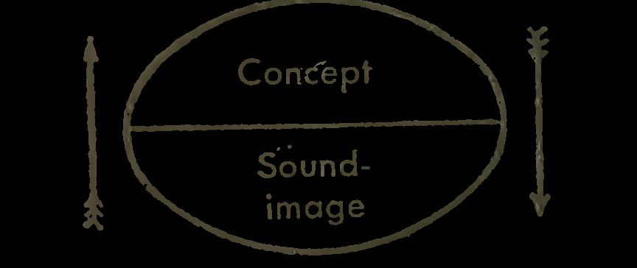
Ferdinand de Saussure
Saussure’s semiology
The linguistic sign is a two-sided psychological entity . It unites not a thing and a name but a concept and a sound image.
The sound image is not the material sound, a purely physical
thing, but the psychological imprint of the sound, the impression that it makes on our senses.

Slide 11
Ferdinand de Saussure’s semiology
SIGN
(the whole)
THE SIGNIFIED (concept)
THE SIGNIFIER (the sound-image)

