Slide 1
Structuralism, Generative grammar and Neo-Humboldtian theories

Slide 2
Structuralism, Generative grammar and Neo-Humboldtian theories
Prague linguistic school.
Louis Hjelmslev’s glossematics.
American descriptive linguistics.
Noam Chomsky’s generative grammar.
Neo-Humboldtian theories.

Slide 3
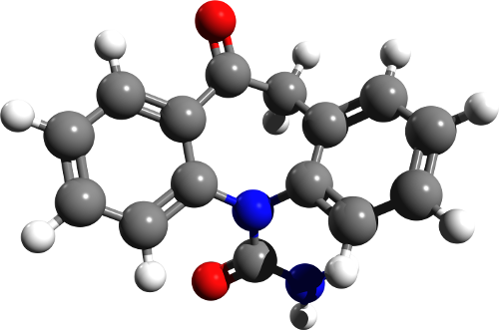
Structuralism
an approach in academic disciplines in general that explores the relationships between fundamental principal elements in language, literature, and other fields upon which some higher mental, linguistic, social, or cultural "structures" and "structural networks" are built.

Slide 4
Prague linguistic school
The Prague school or Prague linguistic circle was an influential group of linguists, philologists and literary critics in Prague in the first half of the 20th c.
They developed methods of structuralist analysis and a theory of the standard language and of language cultivation.
Main interests: phonological theory
Major work: N. Trubetzkoy’s Grundzüge der Phonologie

Slide 5
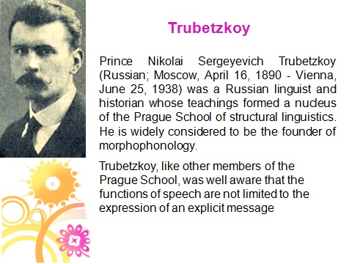
Prague linguistic school

Slide 6
Prague linguistic school
applied Saussurean theory to the elaboration of the phoneme concept
speech sounds belong to speech and phonemes belong to language
treated phonemes not as a mere class of sounds or as a transcriptional device but as complex phonological unit realized by the sounds of speech

Slide 7
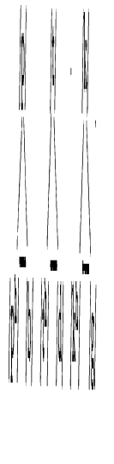
Prague linguistic school
phonological oppositions
each phoneme is composed by a number of separate distinctive features and each distinctive feature stands in a definite opposition to its absence or to another feature in at least one other phoneme in the language
Opposition of voicelessness and voice in English plosives:
/p/-/b/, /t/-/d/, /k/-/g/ pet-bet, tuck –duck, call-gall
Ancient Greek had a three term plosive system:

Slide 8
Prague linguistic school
phonological oppositions
Analysis of phonemes as ordered sets of specific contrasts between a number of distinctive features was a definite advance in phonological theory and descriptive method.
This analysis revealed the complexity of phonological systems. Phonemes enter into different systems of relations in different positions.
/p/-/b/, /t/-/d/, /k/-/g/ contrast as voiceless/voiced in initial, medial and final positions in English, but after initial /s/ the contrast is neutralized – only one plosive can occur in each position.
The same contrast in neutralized in German in the word final position where only voiceless plosives are found.

Slide 9
Prague linguistic school
Similar processes of analysis were applied to prosodic elements (syllable length, stress, pitch, intonation).
Paradigmatic function of sound units and features (they constitute distinctive phonemes) was complemented by their syntagmatic function:
demarcation of syllable and word boundaries

Slide 10
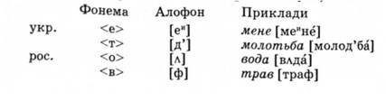
Prague linguistic school
Thus, the phoneme concept had originated in search for the theory of broad transcription. The work of the Prague school made it one of the fundamental elements of linguistic theory as a whole, and of scientific description and analysis of languages.

Slide 11
Prague linguistic school
Contribution to other areas of linguistics:
R. Jacobson studied the category of case in Russian and tried to discover the core semantic component of each case – he applied the method of phonological oppositions to grammatical categories
developed functional approach - studied functions of language and functional styles
Vilém Mathesius’ functional sentence perspective (theme and rheme) as opposed to formal division into syntactical members

Slide 12
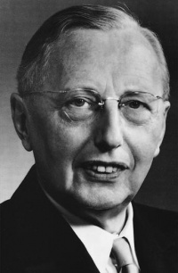
Louis Hjelmslev’s glossematics
Glossematics, system of linguistic analysis based on the distribution and interrelationship of glossemes, the smallest meaningful units of a language—e.g., a word, a stem, a grammatical element, a word order, or an intonation.
Danish scholar Louis Hjelmslev (1899–1965) and his collaborators were strongly influenced by the work of Ferdinand de Saussure.

Slide 13
Louis Hjelmslev’s glossematics
Glossematics is, strictly speaking, not a linguistic theory. Without relying on any specific language it constructs a system which seeks to establish a universal standard defining the necessary and sufficient conditions of language.

Slide 14
American descriptive linguistics (1920s-1950s)
During the 1920s descriptive linguistics received wide recognition in US universities.
1924 the Linguistic Society of America was founded, with its periodical Language
Outstanding representatives: Franz Boas, Edward Sapir and Leonard Bloomfield

Slide 15
American descriptive linguistics (1920s-1950s)
arose from the pragmatic necessity to study mostly preliterate languages of America
prepared descriptive accounts of native languages of America
In many cases the linguists were learning the languages at the same time as they were analysing them >>>>
>>>>> heavy emphasis on “discovery procedures”, so that linguistic theory was virtually required to specify the operations by which a language was to be analysed
focus on synchronic studies caused by linguistic practice (the teaching of language) and the material from North American Indian languages

Slide 16
American descriptive linguistics (1920s-1950s)
Language is an aggregate of speech utterances which are the object of research
focus on the rules of the scientific description (hence the name) of texts
study of the organization, the arrangement and
classification of text elements
formalization of analytical procedures in the area of phonology and morphology (the development of principles for studying language at different levels, of distributive analysis, and of the method of immediate constituents)

Slide 17
American descriptive linguistics (1920s-1950s)
Sapir: ethnolinguistics | Bloomfield : mechanist linguistics
broader treatment of language: language is deeply connected with every sphere of human life | drew on behaviorist or mechanist psychology: mental images, feelings and the like are merely popular terms for various bodily movements speech communication as a series of stimuli and responses
studied the ways in which language and culture influence each other, and he was interested in the relation between linguistic differences and differences in cultural world views. | mechanist interpretation of science, concentrating on methodology and formal analysis
 | Major work: “Language” (1933)

Slide 18
American descriptive linguistics (1920s-1950s)
the two fundamental units of description: phoneme and morpheme
distinction between a speech sound and a phoneme is that between a member and a class
terms:
phone – phoneme – allophone
morph – morpheme – allomorph
снег – снеговик - снежный

Slide 19
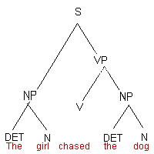
American descriptive linguistics (1920s-1950s)
Sentence structure is set out in terms of immediate constituent analysis.
Syntax is extension of
morphology.

Slide 20
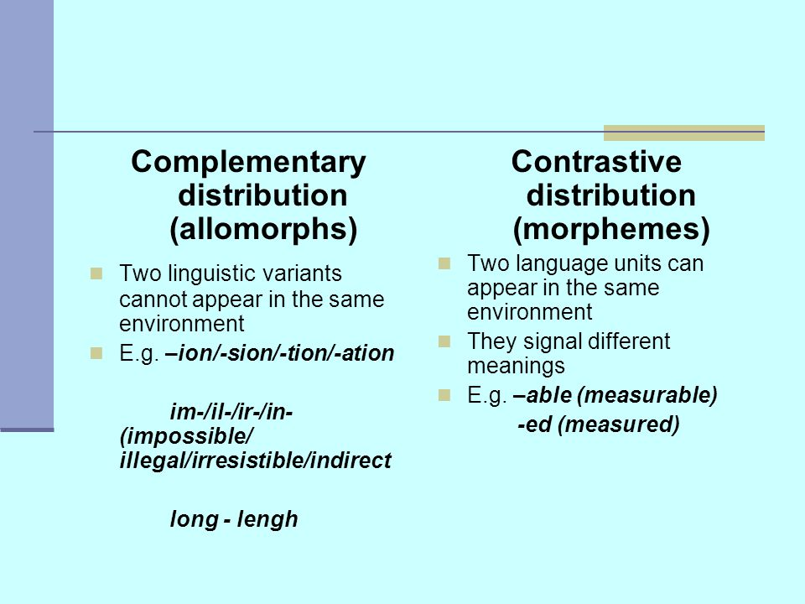
American descriptive linguistics (1920s-1950s)
Distribution analysis

Slide 21
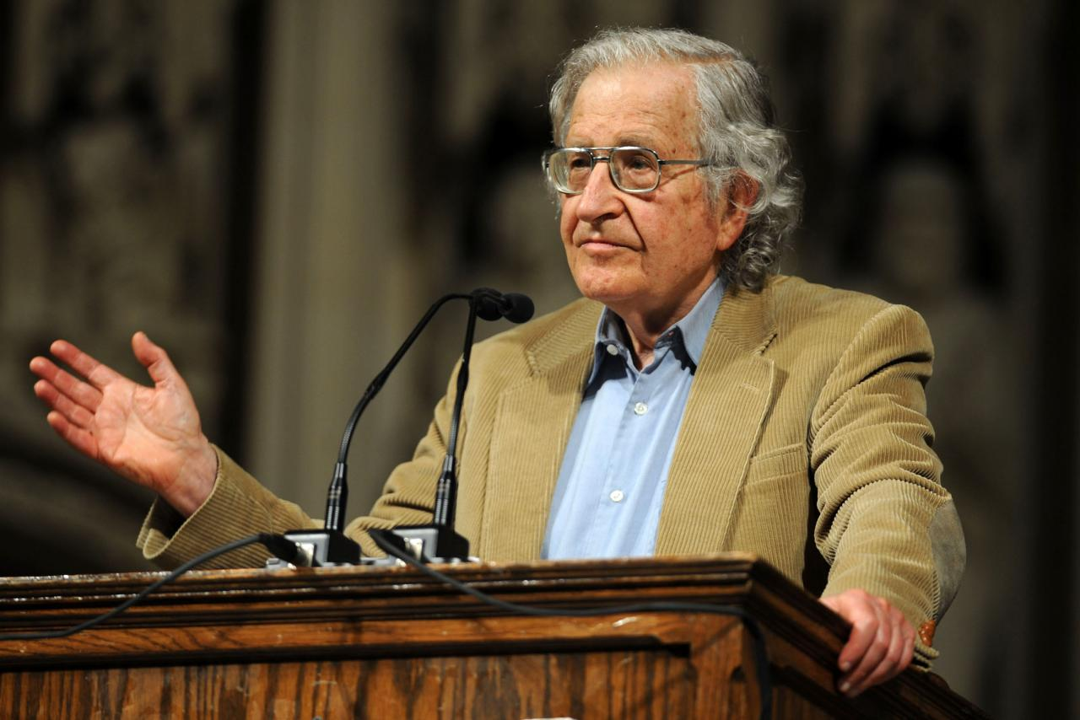
Noam Chomsky’s generative grammar
Noam Chomsky (1928), an American linguist, philosopher, cognitive scientist, historian, logician, social critic, and political activist.
Chomsky is among the most quoted authors in the world (among the top ten and the only living person on the list).

Slide 22

Noam Chomsky’s generative grammar
Chomsky’s universal grammar
grammar is an innate body of knowledge possessed by language users, often termed Universal Grammar (UG)
syntactic knowledge is at least partially inborn - children need only learn certain parochial features of their native languages
the capacity to understand and produce language that the human has and the cat lacks is the language acquisition device (LAD), and one of the tasks for linguistics should be to determine what the LAD is and what constraints it imposes on the range of possible human languages. The universal features that would result from these constraints constitute 'universal grammar’
Language is not learnt , it grows
assisted by LAD

Slide 23
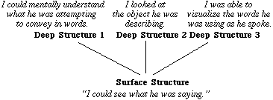
Noam Chomsky’s generative grammar
Chomsky’s transformational generative grammar
language consists of both deep structures and surface structures
Transformational grammar is a generative grammar (which dictates that the syntax, or word order, of surface structures adheres to certain principles and parameters) that consists of a limited series of rules, expressed in mathematical notation, which transform deep structures into well-formed surface structures. The transformational grammar thus relates meaning and sound.

Slide 24
Noam Chomsky’s generative grammar
Chomsky’s transformational generative grammar
But the fundamental reason for the inadequacy of traditional grammars is a more technical one. Although it was well understood that linguistic processes are in some sense "creative," the technical devices for expressing a system of recursive processes were simply not available until much more recently. In fact, a real understanding of how a language can (in Humboldt's words) "make infinite use of finite means" has developed only within the last thirty years, in the course of studies in the foundations of mathematics.
“Aspects of the Theory of Syntax”

Slide 25
Noam Chomsky’s generative grammar
Chomsky distinguished between competence and performance.
He argued that errors in linguistic performance were irrelevant to the study of linguistic competence (the knowledge that allows people to construct and understand grammatical sentences). Consequently, the linguist can study an idealised version of language, greatly simplifying linguistic analysis.

Slide 26
Noam Chomsky’s generative grammar
Types of grammar
Chomsky distinguished between grammars that achieve descriptive adequacy and those that go further and achieve explanatory adequacy.
A descriptively adequate grammar for a particular language defines the (infinite) set of grammatical sentences in that language; that is, it describes the language in its entirety.
A grammar that achieves explanatory adequacy gives an insight into the underlying linguistic structures in the human mind; that is, it does not merely describe the grammar of a language, but makes predictions about how linguistic knowledge is mentally represented.

Slide 27
Neo-Humboldtian theories
American ethnolinguistics
"It is peculiarly important that linguists, who are often accused, and accused justly, of failure to look beyond pretty patterns of their subject matter, should become aware of what their science may mean for the interpretation of human conduct in general. Whether they like it or not they must become increasingly concerned with the many anthropological, sociological, and psychological problems which invade the field of language.“
Edward Sapir

Slide 28
Neo-Humboldtian theories
American ethnolinguistics
No two languages are ever sufficiently similar to be considered as representing the same social reality. The worlds in which different societies live are distinct worlds, not merely the same world with different labels attached.
Edward Sapir

Slide 29
Neo-Humboldtian theories
Edward Sapir
believed that language shapes human perception and directs human behavior. From his view, understanding a culture is impossible without understanding the historical development of that culture’s language
language is not static, it constantly changes ("Language Drift“) Some parts of language change quickly while some are much slower. As reality changes, so does the language.
conversely, due to the change in language, reality changes as well. We think, hear, see, and behave through our language. Language serves as a certain filter through which we experience and interpret reality. Every culture has its own language, or set of filters through which it predisposes its members to certain kinds of experience and thinking. Without language, it is difficult to imagine human life at all.

