Slide 1
Modern trends in linguistics

Slide 2
Modern trends in linguistics
Cognitive linguistics.
Functional grammar.
Text linguistics.
Communicative linguistics.

Slide 3
Linguistics in the 20th century
comparative linguistics
genesis
structural linguistics
system
communicative
linguistics
function

Slide 4
Cognitive linguistics
Cognitive linguistics is an approach to the analysis of natural language that originated in the late 1970s and early 1980s in the work of US linguists George Lakoff, Ron Langacker, and Len Talmy, and that focuses on language as an instrument for organizing, processing, and conveying information.
It emerged as a reaction against the dominant generative paradigm.

Slide 5
Cognitive linguistics
language is not autonomous, it is embedded in the overall cognitive capacities of man; there is no autonomous linguistic faculty in human mind
the formal structures of language are studied as reflections of general conceptual organization, categorization principles, processing mechanisms, and experiential and environmental influences
linguistic knowledge involves not just knowledge of the language, but knowledge of the world as mediated by the language
knowledge of language arises out of language use; the study of language is the study of language use

Slide 6
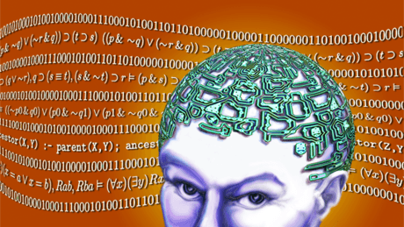
Cognitive linguistics
our interaction with the world is mediated through informational structures in the mind
natural language is a means for organizing, processing, and conveying that information.
language is seen as a repository of world knowledge, a structured collection of meaningful categories that help us deal with new experiences and store information about old ones.

Slide 7
Cognitive linguistics
Three fundamental characteristics of Cognitive Linguistics:
the primacy of semantics in linguistic analysis (the primary function of language is categorization, it involves meaning)
the encyclopedic nature of linguistic meaning (world knowledge is associated with linguistic forms)
the perspectival nature of linguistic meaning (the world is not objectively reflected in the language: the categorization function of the language imposes a structure on the world rather than just mirroring objective reality)

Slide 8
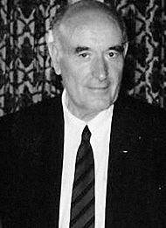
Functional grammar
Alexander Bondarko (1930-2016)
“Functional Grammar: A Field Approach”
the author of the theory
of Functional Semantic Fields (FSF)

Slide 9
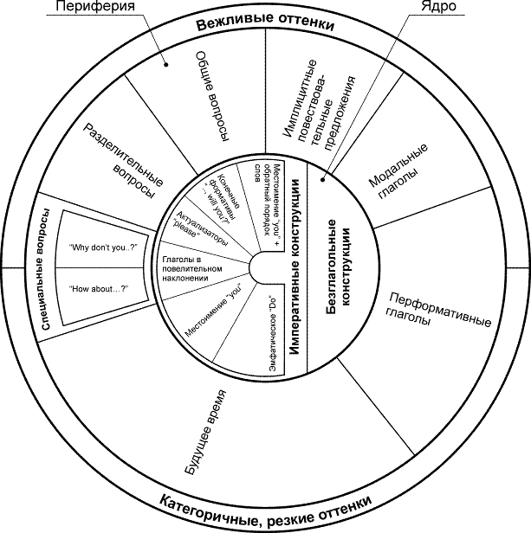
Functional grammar
FSF is a system of language units of various levels (lexical, morphological, syntactical) which perform the same function on the basis of their common categorial content (modality, temporality, possessiveness, aspectuality, intensity etc.)
ФСО спонукальності

Slide 10
Text linguistics
Text linguistics is a branch of linguistics concerned with the description and analysis of extended texts (either spoken or written) in communicative contexts.
Text linguistics overlaps considerably with discourse analysis.

Slide 11
Text linguistics
Approaches to the study of texts
text grammar (Van Dijk) aims to establish a model with which the grammatical structures of texts can be described (quite similar to Chomsky’s transformational approach).
text linguistics is devoted to describing how texts are created and understood and in so doing studies the defining properties of texts - what constitutes their textuality or texture (Crystal).
discourse analysis (Renkema, Schiffrin) traditionally analyses chiefly written texts. However, it seems that it is very difficult to define “discourse” precisely - Schiffrin (1994) for example says that discourse analysis “... is one of the most vast, but also least defined, areas in linguistics”.

Slide 12
Text linguistics
A text is defined as a communicative occurrence which meets seven standards (principles) of textuality:
cohesion,
coherence,
intentionality,
acceptability,
informativity,
contextuality
and intertextuality.

Slide 13
Text linguistics
Cohesion
M.Halliday , R.Hasan “Cohesion in English” (1976)
“The concept of cohesion accounts for the essential semantic relations whereby any passage of speech or writing is enabled to function as text”
Categories of cohesion provide a practical means for describing and analysing texts. They are explicitly expressed in a text:
reference,
substitution,
ellipse,
conjunction
lexical cohesion (synonymy, antonymy, collocation).

Slide 14
Text linguistics
Coherence
Coherence is probably the main component of any form of textual study because if a text is not fully understood a ‘good’ text was not produced.
What makes a text “coherent”?
What makes some texts “acceptable” and others “unacceptable”?
A coherent text has an underlying logical structure that acts to guide the reader through the text so that “it ‘sticks together’ as a unit and creates the feeling that a text hangs together, that it makes sense, and is not just a jumble of sentences.

Slide 15
Text linguistics
Contextuality focuses on the role the context plays in any form of communication. I
In every situation in which language is used, the quality and effect of the communication is determined by the contextual knowledge shared by the participants.
This aspect of language use is studied by pragmatics
and sociolinguistics.
Pragmatics focuses on what the participants in a discourse intend to accomplish through the use of the language (what speech act is performed in a given setting).
Sociolinguistics aims to determine the role knowledge of the
participants (as human beings and in the environment they function as such) plays in the success of a communicative occurrence.

Slide 16
Text linguistics
Text linguistics is a kind of umbrella discipline which makes the study of the different disciplines of linguistics more relevant.
Principle of textuality | Linguistic sub-disciplines
Cohesion | Syntax Semantics Morphology Phonology
Coherence | Semantics Cognitive linguistics
Intentionality | Pragmatics
Acceptability | Pragmatics
Informativity | Semantics Syntax
Contextuality | Pragmatics Sociolinguistics
Intertextuality | Literature theory

Slide 17
Communicative linguistics
Paul Grice (1913-1988), British philosopher of language
Maxims of effective communication
Maxim of Quality
Supermaxim:
Try to make your contribution one that is true
Submaxims:
Do not say what you believe to be false.
Do not say that for which you lack adequate evidence.
Maxim of Quantity
Make your contribution as informative as is required (for the current purposes of the exchange).
Do not make your contribution more informative than is required.
Maxim of Relevance
Be Relevant
Maxim of Manner
Supermaxim:
Be clear and keen
Submaxims:
Avoid obscurity of expression.
Avoid ambiguity.
Be brief.
Be orderly.

Slide 18
Communicative linguistics
Speech-act theory is a subfield of pragmatics concerned with the ways in which words can be used not only to present information but also to carry out actions.
As introduced by Oxford philosopher J.L. Austin (“How to Do Things With Words”, 1962) and further developed by American philosopher J.R. Searle, speech-act theory considers the levels of action at which utterances are said to perform:
Locutionary Acts
Illocutionary Acts
Perlocutionary Acts

Slide 20
Communicative linguistics

Slide 21
Communicative linguistics
Communicative competence refers to both the knowledge of a language and the ability to use it effectively.
The concept of communicative competence (a term coined by linguist Dell Hymes in 1972) grew out of resistance to the concept of linguistic competence introduced by Noam Chomsky (1965). Most scholars now consider linguistic competence to be a part of communicative competence.

