Slide 1
Language as a semiotic system

Slide 2
Language as a semiotic system
Signs and their attributes
Typology of signs
Sign structure
Signs in language
Non-verbal communication

Slide 3
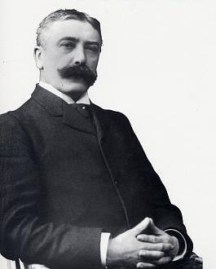
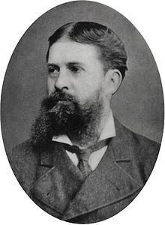
Signs and their attributes
Semiotics (semiology) is the study of signs and sign-using behaviour.
It was defined by one of its founders, the Swiss linguist Ferdinand de Saussure, as the study of “the life of signs within society.”
Although the word was used in this sense in the 17th century by the English philosopher John Locke, the idea of semiotics as an interdisciplinary mode for examining phenomena in different fields emerged only in the late 19th and early 20th centuries with the independent work of Saussure and of the American philosopher Charles Sanders Peirce.

Slide 4
Signs and their attributes
A sign is something which stands to somebody for something.
(Ch. Peirce)
Major attributes of a sign:
its physical nature, which can be sensed
reference to something that is outside the sign (object of reality, abstract notion)
arbitrary connection with the signified
informative nature which allows it to be used in communication
systemic nature (a sign acquires a meaning in a certain system)

Slide 5
Typology of signs
Criticism of dichotomic typology:
any type of semiosis must be based on some degree of conventionality
some signs are neither simply natural nor conventional (pictures)

Slide 6
Typology of signs
Charles Peirce’s classification of signs:
an icon, which resembles its referent (such as a road sign for falling rocks);
an index, which is associated with its referent (as smoke is a sign of fire);
a symbol, which is related to its referent only by convention (as with words or traffic signals).

Slide 7
Typology of signs
Thomas Sebeok’s (1920-2001) classification of signs:
signal – a sign which triggers some reaction on the part of a receiver
symptom – compulsive, automatic, non-arbitrary sign, such that the signifier is coupled with the signified in the manner of a natural link
icon – when there is a typological similarity between a signifier and its denotata
index – its signifier is contiguous with its signified or is a sample of it
symbol – a sign which stands for its referent in a arbitrary, conventional way
name – an identifier sign assigned to the member of a species, that sets the specific member off from the others

Slide 8
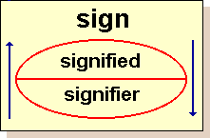
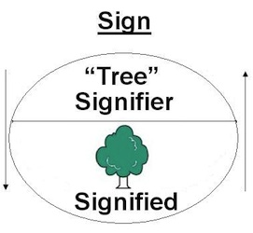
Sign structure
Saussure’s two inseparable components of a sign:
the signifier, which in language is a set of speech sounds or marks on a page,
the signified, which is the concept or idea behind the sign.
The connection between them is arbitrary.

Slide 9
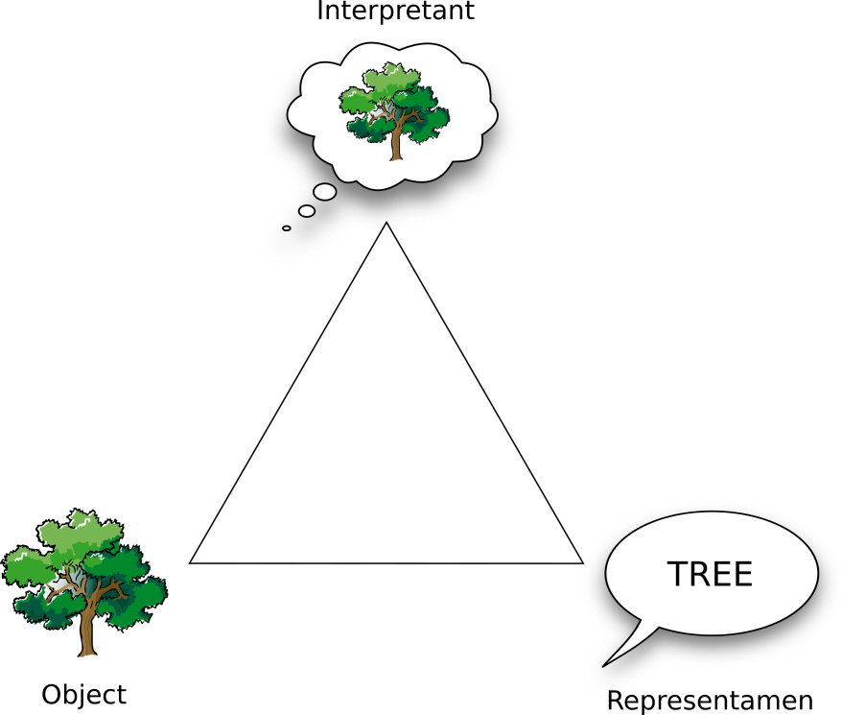
Sign structure
Peirce’s structure of a sign:
the sign,
the sign's subject matter, called its object,
the sign's meaning called its interpretant

Slide 10
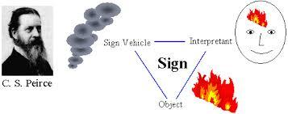
Sign structure
Peirce’s concept of a sign is generalistic, all encompassing.
Non-language reference:

Slide 11
Signs in language
Linguistic sign - any unit of language (morpheme, word, phrase, or sentence) used to designate objects or phenomena of reality.
The relationship between the aspects of a sign is an arbitrary one, since the selection of a sound form does not usually depend on the properties of the designated object.
The peculiarity of the linguistic sign is its asymmetry, that is, the capacity of one signifier to convey various meanings (polysemy or homonymy) and the tendency of the signified to be expressed by various signifiers. The asymmetry of the structure of the linguistic sign determines the language’s capacity for development.
Linguistic signs are sometimes subdivided into complete and partial signs. A complete sign implies an utterance, usually a sentence, directly related to the designated situation (the referent or denotatum of the linguistic sign). A partial linguistic sign is a word or morpheme that is actualized only as part of a complete sign.

Slide 12
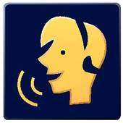
Non-verbal communication
Paralinguistics is the study of vocal (and sometimes non-vocal) signals beyond the basic verbal message or speech.
Paralinguistics, "sets great store on how something is said, not on what is said" (Shirley Weitz “Nonverbal Communication”, 1974).

