Slide 1
Language and thought

Slide 2
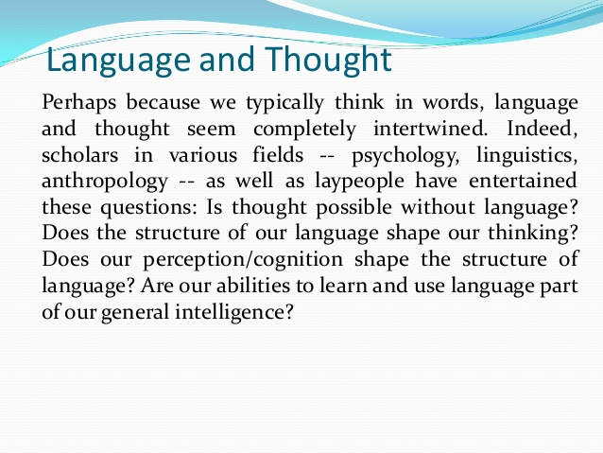

Slide 3
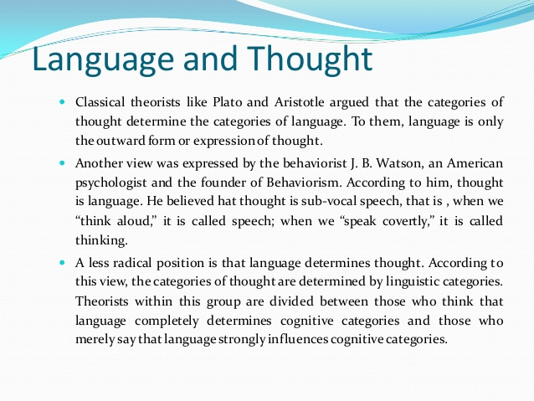

Slide 4
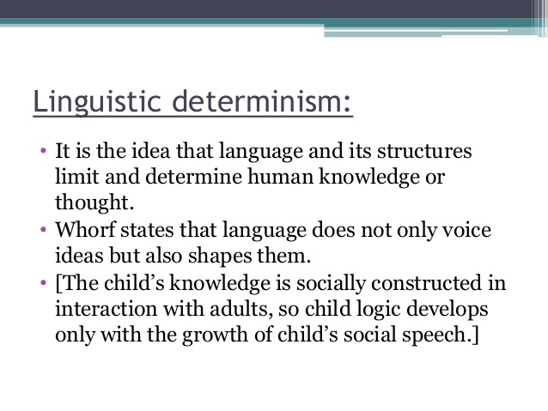

Slide 5
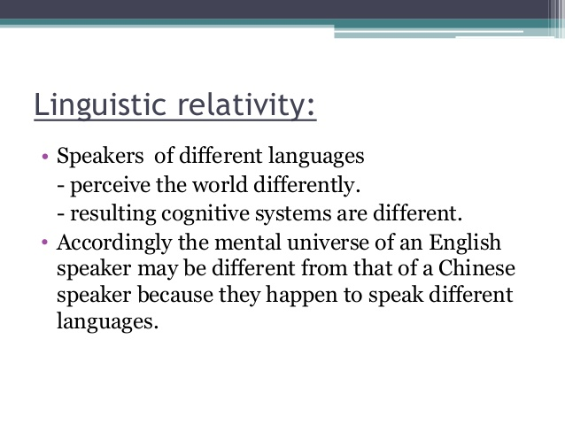

Slide 6
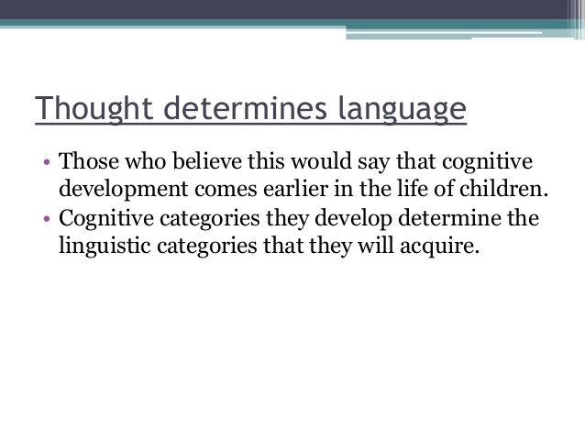

Slide 7
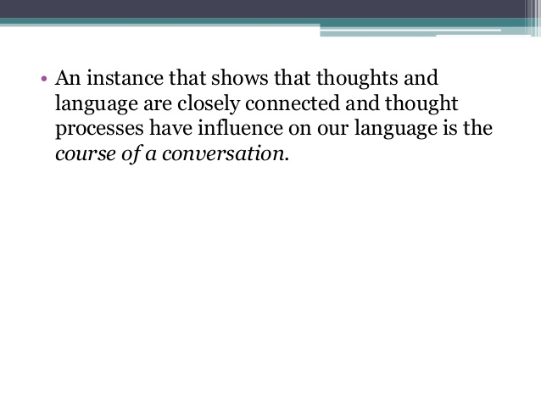

Slide 8

Language and thought
Language and thought are inseparable
changing how people talk changes how they think,
learning new color words enhances a person’s ability to discriminate color,
learning new ways of talking about time imparts a new way of thinking about it

Slide 9

Language and thought
Do animals think?
In this context, thought is more than mere mental images, memories, and experiences and refers to the process of activating mental schemes to acquire new meaning, to reason, analyze and make decisions.

Slide 10
Language and cognition
The new AI tradition and the information processing movement within psychology emphasized learning and was thus opposed to the emphasis on innate knowledge structures which were part of Chomsky’s linguistics.

Slide 11
Language and cognition
In the 1980s and 1990s three scientific developments influenced theories about language-cognition relationship:
connectionism
cognitive linguistics
cognitive neuroscience movement

Slide 12
Language and cognition
Connectionism
It states that behavioral responses to specific stimuli are established through a process of trial and error that affects neural connections between the stimuli and the most satisfying responses.
Connectionism views language as a complex system of units which become interconnected in the mind as they are encountered together. The more often units are heard or seen together, the more likely it is that the presence of one will lead to the activation of the other.
Language acquisition is not just a process of associating words with elements of external reality. It is also a process of associating words and phrases with the other words and phrases that occur with them, or words with grammatical morphemes that occur with them.

Slide 13
Language and cognition
Cognitive linguistics
Cognitive Linguistics views linguistic knowledge as part of general cognition and thinking; linguistic behaviour is not separated from other general cognitive abilities which allow mental processes of reasoning, memory, attention or learning, but understood as an integral part of it.
Language offers a window into cognitive function, providing insights into the nature, structure and organization of thoughts and ideas. The most important way in which cognitive linguistics differs from other approaches to the study of language, then, is that language is assumed to reflect certain fundamental properties and design features of the human mind.“
(Vyvyan Evans and Melanie Green, Cognitive Linguistics: An Introduction. Routledge, 2006)

Slide 14
Language and cognition
Cognitive neuroscience movement
The regions of the brain that mediate language use are particularly adaptable. Like other aspects of cognition, language acquisition is heavily dependent on experience.
Regional specialization in the brain is beyond doubt but modularity of the cognitive functions, including language, is highly debatable from the point of view of neurobiology and evolution.
Language has an epigenetic, not genetic origin. Epigenetic development is the proposal that behaviour results from a complex dynamic evolution of genes and environmental forces during both prenatal and postnatal development.
Cognitive abilities emerge from a biological structure which evolves, both before and after birth, in tandem with environmental forces.

Slide 15
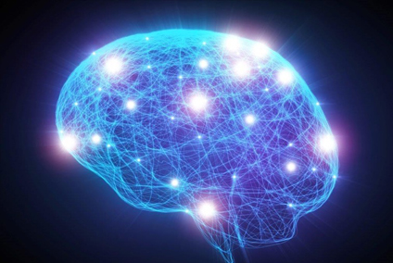
Basics of neurolinguistics
Neurolinguistics is the study of how language is represented in the brain: that is, how and where our brains store our knowledge of the language (or languages) that we speak, understand, read, and write, what happens in our brains as we acquire that knowledge, and what happens as we use it in our everyday lives.

Slide 16
Basics of neurolinguistics
Neurolinguists try to answer the following questions:
What about our brains makes human language possible – why is our communication system so elaborate and so different from that of other animals?
Does language use the same kind of neural computation as other cognitive systems, such as music or mathematics?
Where in your brain is a word that you've learned?
How does a word ‘come to mind’ when you need it (and why does it sometimes not come to you?)
If you know two languages, how do you switch between them and how do you keep them from interfering with each other?
If you learn two languages from birth, how is your brain different from the brain of someone who speaks only one language, and why?

Slide 17
Basics of neurolinguistics
Neurolinguistics is deeply entwined with psycholinguistics.
Neurolinguistics - the study of the neural mechanisms in the human brain that control the comprehension, production, and acquisition of language.
Psycholinguistics - the psychology of language, including language acquisition by children, the mental processes underlying adult comprehension and production of speech, language disorders, etc

Slide 18
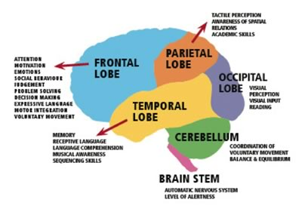
Basics of neurolinguistics
How our brain works
Our brains store information in networks of brain cells.
These neural networks are ultimately connected to the parts of the brain that control our movements (including those needed to produce speech) and our internal and external sensations (sounds, sights, touch, and those that come from our own movements). The connections within these networks may be strong or weak, and the information that a cell sends out may increase the activity of some of its neighbors and inhibit the activity of others. Each time a connection is used, it gets stronger. Densely connected neighborhoods of brain cells carry out computations that are integrated with information coming from other neighborhoods, often involving feedback loops. Many computations are carried out simultaneously (the brain is a massively parallel information processor).

Slide 19
Basics of neurolinguistics
How our brain works
Learning information or a skill happens by establishing new connections and/or changing the strengths of existing connections. These local and long-distance networks of connected brain cells show plasticity – that is, they can keep changing throughout our lives, allowing us to learn and to recover (to some extent) from brain injuries.
For people with aphasia (language loss due to brain damage), depending on how serious the damage is, intense therapy and practice may bring about major improvements in language as well as in movement control.

Slide 20
Basics of neurolinguistics
New findings
extensive networks involving areas remote from the traditional language areas are deeply involved in language use,
the language areas are also involved in the processing of non-language information, such as some aspects of music,
the correlations of particular areas of the brain with particular language impairments are much poorer than had been thought.

