Slide 1
Language and speech

Slide 2
Saussure’s theory
Language is a general human ability to create a system of signs that is not inherited.
Langue is a system of all rules that must be observed by all speakers of the community speaking a particular language. It is only this system that enables individuals to communicate and understand one another. Langue as a social phenomenon is, thus, the property of the society.
Parole is an individual phenomenon. It is a concrete manifestation of langue uttered by an individual in a given moment.

Slide 3
Saussure’s theory
Saussure points out that langue and parole are completely different things.
Speech:
individual and spontaneous
fugitive
tied to particular contexts
may contain “errors”, like “slops of tongue”, and will almost certainly contain hesitations, false starts, sentences broken off halfway through etc.
F. de Saussure claims that data of this sort do not constitute an appropriate object of study since they are inherently idiosyncratic and influenced by too many extraneous factors: psychological, social and individual.

Slide 4
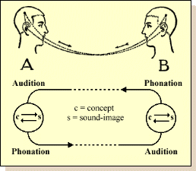
Saussure’s theory
Saussure’s model of a speech act

Slide 5
Views on language-speech relationship after Saussure
Leonard Bloomfield’s inconsistency
We must study people's habits of language - the way people talk - without bothering about the mental processes that we may conceive to underlie or accompany these habits.
Language consists in speech >> Speech is the proper subject-matter of linguistic analysis.

Slide 6
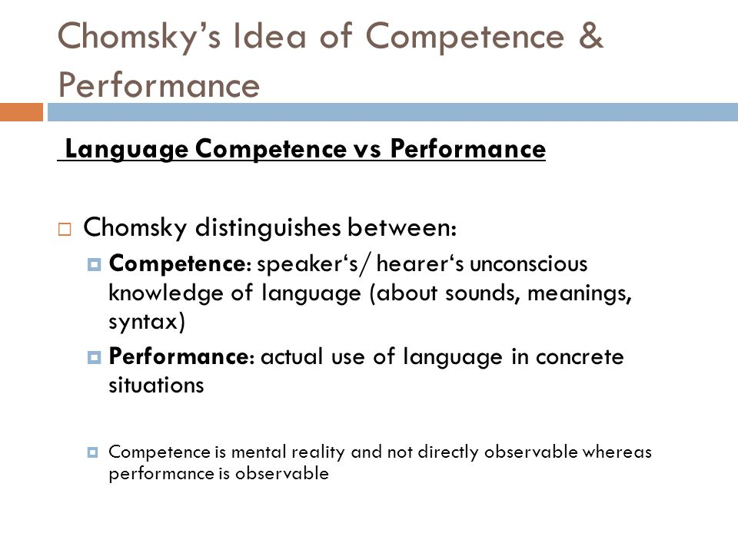
Views on language-speech relationship after Saussure

Slide 7
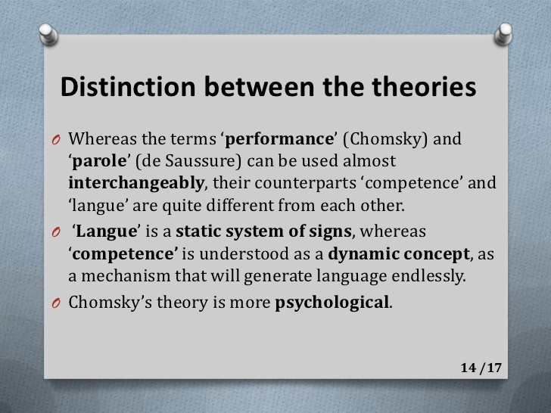
Views on language-speech relationship after Saussure

Slide 8
Views on language-speech relationship after Saussure
Louis Hjelmslev
Schema | Usage
Linguistic hierarchy discovered by deduction | Non-linguistic hierarchy discovered by the analysis of purport
It is constant | It is variable
Ever-present realizable possibility | Can come into being and die out
Latent rather than manifested | Manifested

Slide 9

Views on language-speech relationship after Saussure
Л.В. Щерба
Речевая деятельность - процессы говорения и понимания.
Языковые системы - словари и грамматики языков, которые "будучи концептами, в непосредственном опыте (ни в психологическом, ни в физиологическом) нам вовсе не даны, а могут выводиться нами лишь из процессов говорения и понимания».
Языковой материал - это "не деятельность отдельного индивида, а совокупность всего говоримого и понимаемого в определенной конкретной обстановке в ту или иную эпоху жизни данной общественной группы. На языке лингвистов это "тексты" .

Slide 10
Views on language-speech relationship after Saussure
Eugen Coșeriu
language system
a set of unlimited possibilities
never totally implemented
norm
implemented possibilities of a language system (traditions) existing in the human mind in the form of language ability
does not include potential possibilities
individual speech
free activity

Slide 11
Views on language-speech relationship after Saussure
А.И. Смирницкий
речь представляет собой «сырой материал исследования», а язык - «предмет изучения, извлекаемый из этого материала»
Язык - совокупность взаимообусловленных и взаимосвязанных единиц и отношений между ними.
Внешняя речь
Устная речь
Письменная речь
Внутренняя речь
Мысленная речь

Slide 12
Current views on language-speech relationship
Language
general
permanent, long-lasting
Speech
specific
transitory
potential, model
knowledge
realization
use
unfolds in time and is realized in space
does not have temporal or spatial parameters
linear and syntagmatic
paradigmatic and hierarchical
finite as a system
infinite
contextual and situationally determined
does not depend on circumstances of communication
related to objective reality, can be true or false
can not be assessed as true or false

Slide 13
Current views on language-speech relationship
Major approaches
epistemological (philosophical)
language is general, abstract; speech is specific
dialectically connected, they remain relatively independent
ontological (linguistic)
language is mental; speech is psychophysiological
language-speech relationship can be looked upon as the relationship between an ideal and a material phenomena
pragmatic (functional)
language is stable and socially accepted
speech is occasional, accidental and fugitive
language as a system is not observable; speech can be observed and studied as realization of language
language has potential existence

Slide 14
Current views on language-speech relationship
Language is not utterly social and speech is not utterly individual
social
individual
storage of language
generation of speech
function of language
essence of speech as a tool of communication

Slide 15
Current views on language-speech relationship
Speech
has two forms: monological and dialogical
has speed, tonal quality, loudness, articulatory clarity, accent, etc.
reflects the speaker’s emotional state and character
can be evaluated in terms of content, expressiveness, correctness, style, etc.

