Slide 1
Birth of comparative and historical linguistics

Slide 2
Birth of comparative-historical linguistics
William Jones and other forerunners of historical linguistics.
Franz Bopp, Rasmus Rask, Jacob Grimm and Alexander Vostokov as founders of comparative-historical linguistics.
Wilhelm von Humboldt’s linguistic heritage.

Slide 3
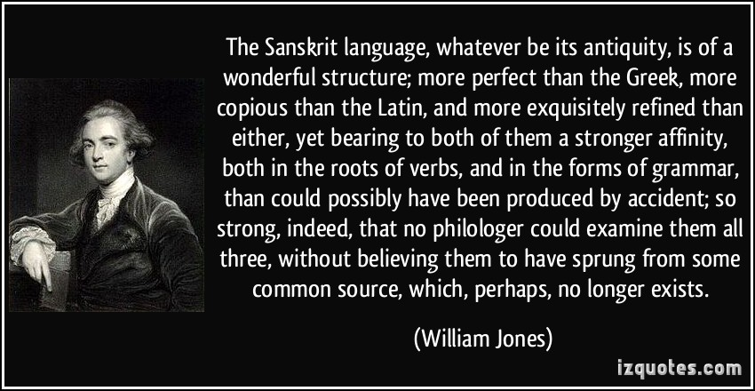
William Jones and other forerunners of historical linguistics
1786 Sir William Jones In his Third Anniversary Discourse to the Asiatic Society in Calcutta suggested that Sanskrit, Greek and Latin languages had a common root, and that indeed they may all be further related, in turn, to Gothic and the Celtic languages, as well as to Persian.

Slide 4
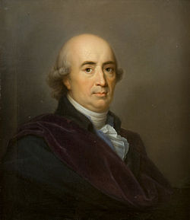
William Jones and other forerunners of historical linguistics
.
Johann Gottfried Herder
(winner of the prize)
“Treatise on the Origin of Language” (1772)
Thought is essentially dependent on, and bounded in scope by, language — i.e. one can only think if one has a language, and one can only think what one can express linguistically.
Meanings or concepts are to be equated with usages of words.
Conceptualization results from sensation. We are able to achieve non-empirical concepts by means of a sort of metaphorical extension from the empirical ones.

Slide 5
William Jones and other forerunners of historical linguistics
.
Johann Gottfried Herder on the origin of the language:
Language is not a gift from God.
Man has his five senses, and he is gifted with reason; nevertheless, with all his talents he would be forlorn in the world without his specific human language. Creation of language and culture by means of his natural talents is distinctive of man’s nature.
Sound, a product of the human tongue, and conception, a product of the human reason, must be adjusted to each other.

Slide 6
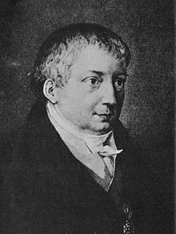
William Jones and other forerunners of historical linguistics
Friedrich Schlegel
„Über die Sprache und Weisheit der Indier“ (1808)
stressed the importance of studying the “inner structures” of languages (i.e. their morphology) for the better understanding of their genetic relationship
was the first to use the term “comparative grammar”
compared Sanskrit with Latin, Greek, Persian and German and found similarities in vocabulary and grammar

Slide 7
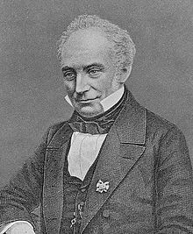
Franz Bopp, Rasmus Rask, Jacob Grimm and Alexander Vostokov as founders of comparative-historical linguistics
Franz Bopp(1791-1867), German linguist
“Über das Conjugationssystem der Sanskritsprache in Vergleichung mit jenem der griechischen, lateinischen, persischen und germanischen Sprache“ (1816)
traced the common origin of those languages' grammatical forms, of their inflections
planned to reconstruct the original grammatical structure of the language whose gradual disintegration produced languages of the Indo-European family

Slide 8
Franz Bopp, Rasmus Rask, Jacob Grimm and Alexander Vostokov as founders of comparative-historical linguistics
Franz Bopp(1791-1867), German linguist
“Ausführliches Lehrgebäude der Sanskritsprache “ (1827)
„Vergleichende Grammatik des Sanskrit, Zend, Griechischen, Lateinischen, Litthauischen, Altslawischen, Gotischen und Deutschen“
(1833-1852)
Aims:
comparative description of the languages concerned
investigation of the laws governing them
discovery of the origin of their inflectional forms

Slide 9
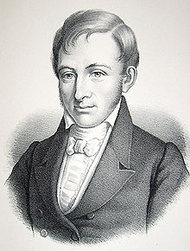
Franz Bopp, Rasmus Rask, Jacob Grimm and Alexander Vostokov as founders of comparative-historical linguistics
Rasmus Rask (1787-1832)
Danish linguist
author of the first systematic grammars of Old Norse and Old English
brought order into etymological relationships by setting out systematic comparisons of word forms, matching a sound in one language with a sound in another exemplified in numbers of different words
discovered correspondences known as Germanic Sound Shift
“If there is found between two languages agreement in the forms of indispensible words to such an extent that rules of letter changes can be discovered for passing from one to the other, then there is a basic relationship between these languages”

Slide 10
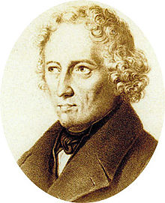
Franz Bopp, Rasmus Rask, Jacob Grimm and Alexander Vostokov as founders of comparative-historical linguistics
Jacob Grimm(1785-1863)
German philologist, author of Deutsche Grammatik (1822)
formulated the first of the sound laws that were to form the structure and support of Indo-European and other language families
“The sound shift is a general tendency; it is not followed in every case”
believed that philology must be based on strict adherence to the laws of sound change to be scientific

Slide 11
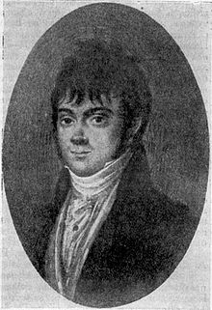
Franz Bopp, Rasmus Rask, Jacob Grimm and Alexander Vostokov as founders of comparative-historical linguistics
Alexander Vostokov (1781-1864)
Russian philologist, author of «Рассуждение о славянском языке, служащее введением к Грамматике сего языка, составляемой по древнейшим оного письменным памятникам» (1820)
the first work on historical phonetics of the Slavonic languages as a group of Indo-European languages

Slide 12
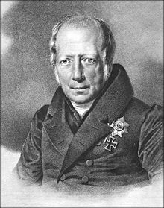
Wilhelm von Humboldt’s linguistic heritage
Wilhelm von Humboldt (1767-1835)
Prussian philosopher, government official, reformer of education, linguist
„Über die Verschiedenheit des menschlichen Sprachbaus und ihren Einfluss auf die geistige Entwicklung des Menschengeschlechts“

Slide 13
Wilhelm von Humboldt’s linguistic heritage
Humboldt’s theory of language lays stress on the creative linguistic ability inherent in every speaker’s mind:
language is not the product of speaking and writing, it is the living capability by which speakers produce and understand utterances.

Slide 14
Wilhelm von Humboldt’s linguistic heritage
Language is an essential part of the human mind
Languages can be changed and adapted as circumstances require
that explains the mystery of language:
Speakers can make infinite use of the finite linguistic resources available to them at any time
No matter how much you describe or analyze a language, something of its essential nature always remains unsaid

